Slide 1
Professional writing skills in English
Dr.Udayakumar.HM, Assistant Professor, RIT

Slide 2
UNIT I
Identifying Common errors in Writing and Speaking English
Identifying common errors while using the parts of Speech, Use of Verbs & Phrasal verbs, Auxiliary verbs and their forms, Subject verb agreement (Concord rules), Identifying common errors in Subject verb agreement and Tenses
UNIT II
Nature and style of Sensible writing
Principles of Formal writing, building introduction, key points and conclusion, Importance of proper punctuation, Usages of connectives, precise writing, Essay writing, Words commonly confused/ misused
UNIT III
Technical reading & writing practices
Introduction to technical writing, Report writing, significance of reports, types of Reports, Introduction to Technical proposal writing, Types of Technical proposals, Characteristics of technical proposals, Grammar-Voices & Reported speech

Slide 3
UNIT IV
Professional Communication for Employment
Listening Comprehension, Types of Listening, Barriers, Improving listening skills, Reading Comprehension, Tips for effective reading, job Application, Drafting effective Resume/curriculum vitae, Writing formal Email
UNIT V
Professional Communication skills at Workplace
Intra interpersonal communication skills at workplace, significance of non-verbal communication Group discussion and presentation skills, strategies for effective GD and Presentation skills, interview skills

Slide 4
Text Books:
Meenakshi Raman & Sangeetha Sharma - Technical communication – Principles and Practice, Oxford University Press – 2007.
A.J. Thomson & A. V. Martinet, A Practical English Grammar, Oxford University Press –1987.
Reference Books:
M Ashraf Rizvi, Effective Technical Communication, McGraw Hill Education (India) Private Limited-2005.
Sanjaya kumar, Communication Skills, Pushpa Lata, Oxford Press, 2016.
Dr. Premila D Swamy & Udayakumar.HM, Communication skills for Engineers, Archers and Elevators Publishing House Bangalore, India, 2021.
S K. Khandelwal & R K Gupta, Functional Grammar & Composition, Laxmi Publication (P) Ltd.
N. Krishna Murthy, Modern English Grammar, Trinity press, 2016.
John Seely - The Oxford Guide to Effective Writing and Speaking. OUP, 2005.
Oxford Advanced Learners’s Dictionary, 8th edition, 2013.
Martin Hewings - Advanced Grammar in Use, Cambridge University Press, 2013.

Slide 5
UNIT I
Identifying Common errors in Writing and Speaking English
Identifying common errors while using the Parts of Speech
Use of Verbs & Phrasal verbs, Auxiliary verbs and their forms
Subject verb agreement (Concord rules),
Identifying common errors in Subject verb agreement and Tenses
Dr.Udayakumar.HM, Assistant Professor, RIT

Slide 6
PARTS OF SPEECH
1. Noun
2. Pronoun
3. Verb
4. Adverb
5. Adjective
6. Preposition
7. Conjunction
8. Interjection
PIVAN CAP

Slide 7
PARTS OF SPEECH
1. I applied for a bank loan.
2. Banks play an important role in a country.
3. You should not bank on your friends for help.

Slide 8
PARTS OF SPEECH
1. Nouns: A noun is a word used to name something: a person/animal, a place, a thing, or an idea.
Nouns are classified in several ways…
1. Nouns can be singular or plural.
2. Proper nouns
3. Common Nouns
4. Nouns can also be collective.
5. Nouns can also be either count or non-count.
6. Nouns can be Abstract or Concrete.

Slide 9
2. Pronouns: A pronoun is a word that replaces a noun. They eliminate the need for repetition. There are several types of pronouns.
1. Personal Pronouns: refer to specific persons or things. Personal pronouns can act as subjects, objects, or possessives.
Singular: I, me, (first person)/ you (Second person)/
She, her, he, him, it (Third person),
Plural: we, us (First person)/ you (Second person)/
They, them (Third person),
I, you, she, he, it, we, and they are used as subjects of sentences.
For example: She knew the grammar rules very well.

Slide 10
The personal pronouns that can be used as objects are:
Me, you, him, her, it, them
2. Possessive Pronouns indicate ownership or possession.
Singular: my, mine, your, yours, hers, his, its
Plural: yours, ours, theirs,
For Example: She returned my pencil to me because it was mine.
3. Reflexive Pronouns name a receiver of an action who is identical to the doer of the action.
Singular: myself, yourself, himself, herself, itself
Plural: ourselves, yourselves, themselves
For example: Manuela congratulated herself on her good grades.
Here, Manuela is both the doer and the receiver of the action.
Q: So, who did Manuela congratulate? A: Herself.

Slide 11
4. Reciprocal Pronouns express shared actions or feelings.
They are: Each other, one another.
For Example:
Yan Ko and Tai help each other with their homework.
Leon and his girlfriend dance with one another when they go clubbing.

Slide 12
5. Demonstrative Pronouns are also considered noun markers. They "point" towards nouns.
this, that, these those.
For Example: That woman attends Gainesville College. That points out which woman.
The woman attends Gainesville College.
Q: Which woman? A: That woman.
6. Interrogative Pronouns introduce questions.
Who, Whom, Whose, Which, What
For Example:
Who is going on vacation? To whom will the teacher give an "A"?
What are you doing?

Slide 13
3. Verbs: Verbs generally express action or a state of being. There are several classifications for verbs- action verbs,/linking verbs, main verbs/auxiliary verbs, transitive/intransitive and phrasal verbs.
1. Action verbs show action.
He runs. He plays. They study.
2. Linking Verbs link the subject to an adjective.
Ricky Martin is beautiful.
The linking verb is links the adjective beautiful with the subject Ricky Martin.
1. Main verbs can stand alone.
2. Auxiliary verbs, also called helping verbs, serve as support to the main verb.

Slide 14
Verbs can be transitive or intransitive.
1. Transitive Verbs require a direct object in order to make sense. For Example:
Yolanda takes aspirin for her headaches. Here, takes is a transitive verb since the sentence Yolanda takes has no meaning without its direct object aspirin.
2. Intransitive Verbs do not need direct objects to make them meaningful.
For Example: Julio swims. The verb swim has meaning for the reader without an object.
For Example:
The cars race. – Here, race is intransitive. It does not need an object.
My father races horses. – Here, a race is transitive. It requires the object horses in order to make sense.

Slide 15
4. Adverbs: An adverb is a word that modifies an action verb, an adjective or another adverb.
Types of Adverbs:
1. Adverbs of manner describe the manner of an action done by the verb. They are happily, effectively etc.
They lived happily.
2. Relative Adverbs introduce questions and dependent adverbial clauses. They answer the questions When? and Where? They are: When Where When I was young, I liked to play outside.
Q: When did I like to play outside? A: When I was young.
3. Adverbs of Frequency indicate answer the question how often? They are: Always, usually, often, sometimes, rarely, never
The students in ESOL 98 always study very hard.
They rarely forget to do their homework.

Slide 16
4. Adverbs of place refers where the action done. They are here, there etc.
I went there.
Please come here.
5. Adverbs of time describe when the action is done. They are now, yesterday, soon etc.
She will come here soon.
They came yesterday.
6. Adverbs of degree describe how the action is done. They are how long, very etc.., soon etc.
How long will you stay in Bangalore?
He is very great.

Slide 17
5. Adjectives: An adjective modifies (describes) a noun or pronoun. Normally in English, the adjective comes before the noun.
I feel happy.
She is afraid.
Kinds of Adjectives:
1. Adjective of quality: An adjective is used to talk about the quality of the person or thing is known as adjective of quality.
For example: Wealthy, regional, industrial, fundamental, elementary, and primary.
Telugu is regional language.
2. Adjective of quantity: An adjective is used to talk about the quantity of things is known as adjective of quantity.
For example: little, much, enough, no, any, whole, all, great, half, sufficient.
There is a little milk in the jug.
My father earned enough money.

Slide 18
3. Adjective of number: An adjective is used to talk about the number of the things is known as adjective of quality.
For example: five, few, first, one.
Only few people are kind to the poor.
4. Demonstrative adjective: An adjective is used to point out the persons or things are known as Demonstrative adjective.
For example: This, that, these, those.
This book is very interesting.

Slide 19
6. Prepositions: Prepositions are words that, like conjunctions, connect a noun or pronoun to another word in a sentence. Some common prepositions:
1. Simple prepositions are as, to, of, by etc.
2. Double prepositions constitute two words they are out of, next to etc.
3. Compound prepositions are about, above, inside etc.
4. Phrase prepositions are in favour of, on account of, in order to, in addition to etc.
7. Conjunctions: They join together words and phrases. There are three kinds of conjunctions: coordinating conjunctions, correlative conjunctions, and subordinating conjunctions.
I like to have tea and coffee.
1. Coordinating Conjunctions There are seven coordinating conjunctions in English. You can use the mnemonic device fan boys to remember them.
For, And, Nor, But, Or, Yet, So,
Ignacio loves to dance, but Rocío has no rhythm.

Slide 20
2. Correlative Conjunctions also join ideas, but they do not work in pairs. They are:
Both…and, neither…nor, whether…or, either…or, not only…but also
Not only am I happy about the grades, but I am also excited that you are learning!
3. Subordinating Conjunctions join an independent clause to a subordinate clause. That is, they join a clause that can stand alone with a clause that cannot stand alone. Some frequently used subordinating conjunctions are:
After, although, as, as if, because, before, even if, even though, if, since, so that, though, unless, until, when, whenever, where, wherever, whether, while.
4. Compound/Combined Conjunctions also join ideas, but they work in pairs. They are: as well as, as soon as, so that etc.

Slide 21
8. Interjections:
Interjections are words used to express emotional states. They can usually be found in narrative writing, interviews, and in spoken English. They can stand alone.
For example:
Oh! Wow! Ouch! Oops! Hey!
Punctuation Note: They are punctuated with either commas or exclamation marks. Mild interjections are followed by a comma, but stronger interjections are punctuated with an exclamation mark (!).
Oh, we’re late for the movie.
Generally, the movie is not an important destination. Therefore, the person making this statement will sound less urgent than the next example.
Oh! I’m late for work.

Slide 22
Identify the parts of speech for the underlined words given in the paragraph below.
An engineer might interact with technology all day, but that doesn't mean he has no interaction with other people. He communicates with other engineers, with team members outside of engineering and often with customers as well. Within engineering, effective communication makes it possible to transform requirements into the best possible working or workable solutions. Outside of engineering, effective communication makes it possible to verify the team is working on all of the right requirements, and to ensure the resulting solution can, in fact, be implemented. While all engineers should have good communication skills, global engineers face additional challenges, making effective communication an imperative.

Slide 23
Answers
1.Engineer: Noun
2.Communicates: Verb
3.Often: Adverb
4.Effective: Adjective
5.Of: Preposition

Slide 24
Use of Verbs & Phrasal verbs, Auxiliary verbs and their forms

Slide 25
USAGE OF TENSE FORMS
Dr.Udayakumar.HM, Assistant Professor, RIT

Slide 26
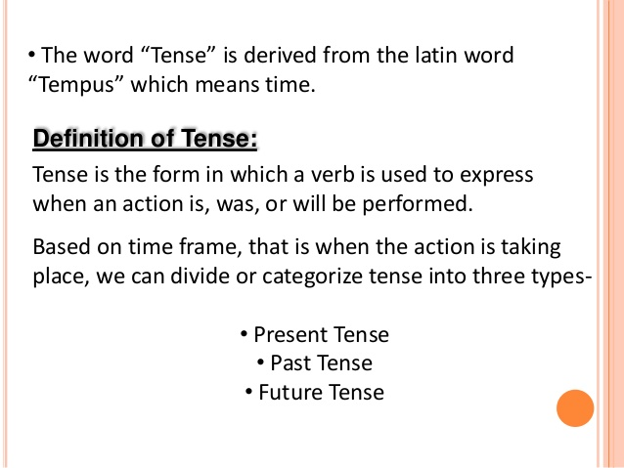


Slide 27
TYPES OF TENSES : 1. PRESENT TENSE:
1.1. Present simple (I DO) [Subject + Am/is + verb]
A. We use the present simple to talk about things in general. We are not thinking only about now. We use it to say that something happening, happens all the time or repeatedly, or that something is true in general. It is not important whether the action is happening at the time of speaking.
I usually go away at weekends.
The earth goes round the sun.

Slide 28
TYPES OF TENSES : 1. PRESENT TENSE:
1.1. Present simple (I DO) [Subject + Am/is + verb]
We use simple present to make affirmative and negative sentences.
Affirmative Sentences. Negative sentences
Subject | Verb | Complement
I/we/you/ they He/she/it | Don’t Doesn’t | Work. Come.
Subject | Verb | Complement
I We You | talk understand speak | English well.
He She It | reads writes imitates
They | Communicate

Slide 29
1.2. Present continuous (I am doing) [Subject + Am/is/are + verb+ ing]
A. Anna is in her car. She is on her way to work.
She is driving to work.
This means: She is driving now. At the time of speaking. The action is not finished.
B. I am doing something= I am in the middle of something. I have started doing it and haven’t finished yet.
Often the action is happening at the time of speaking.
Please don’t make so much noise. I am working. (not I work)
C. We use the present continuous when we talk about things happening in a period around now. (Today, this week, this evening)
You’re working hard today. Yes I have a lot to do. (not to work hard today)

Slide 30
1.2. Present continuous (I am doing) [Subject + Am/is/are + verb+ ing]
We use present continuous to make affirmative and negative sentences.
Affirmative sentences. Negative sentences.
S | HV | MV | Complement |  | S | HV | MV | Complement
I We You | am are are | speaking talking understanding | English well. |  | I We You | am are are | not speaking not talking not understanding | English well.
He She It | is is is | reading writing imitating |  |  | He She It | is is is | not reading not writing not imitating
They | are | Communicating |  |  | They | are | not communicating

Slide 31
1.3. Present perfect (I have done) [Subject + has/have + Past form of verb (V3)] :
We use the Present Perfect to say that an action happened at an unspecified time before now. The exact time is not important. You CANNOT use the Present Perfect with specific time expressions such as: yesterday, one year ago, last week, when I was a child, when I lived in Japan, at that moment, that day, one day, etc. We CAN use the Present Perfect with unspecific expressions such as: ever, never, once, many times, several times, before, so far, already, yet, etc.
Examples:
You have seen that movie many times.
You have not seen that movie many times.
Have you seen that movie many times?
We use the present perfect there is always connection with now. The action in the past has a result now.
Where is your key? I don’t know. I have lost it. (I haven’t got it now)
He told me his name but I have forgotten it. (I can’t remember it now)

Slide 32
1.3. Present perfect (I have done) [Subject + has/have + Past form of verb (V3)] :
S | HV | MV | Complement |  | S | HV | MV | Complement
I We You | have have have | spoken talked understood | English well. English well. |  | I We You | have have have | not spoken not Talked not understood | English well.
He She It | has has has | read written imitated |  |  | He She It | has has has | not read not written not imitated | English well.
They | have | communicated |  |  | They | Have | not communicated | English well.

Slide 33
1.4. Present perfect continuous: (I have been doing) [Subject + Has/have + been + ing]
We use the Present Perfect Continuous to show that something started in the past and has continued up until now. "For five minutes," "for two weeks," and "since Tuesday" are all durations which can be used with the Present Perfect Continuous.
Examples:
She has been working at that company for three years.
James has been teaching at the university since June.

Slide 34
1.4. Present perfect continuous: (I have been doing) [Subject + Has/have + been + ing]
S | HV | MV | Complement |  | S | HV | MV | Complement
I We You | have been | speaking talking understanding | English well. English well. |  | I We You | haven’t been haven’t been haven’t been | speaking talking understanding | English well. English well.
He She It | has been | reading writing imitating |  |  | He She It | hasn’t been | Reading writing imitating
They | have been | Communicating |  |  | They | haven’t been | Communicating

Slide 35
2. PAST TENSE: 2.1. Simple Past: [Subject + Past form of verb (V2)]
Use the Simple Past to express the idea that an action started and finished at a specific time in the past. Sometimes, the speaker may not actually mention the specific time, but they do have one specific time in mind.
Examples:
I saw a movie yesterday.
I didn't see a play yesterday.
We use simple past to make affirmative and negative sentences.
Affirmative sentences Negative sentences.
Subject | Verb | Complement |  | Subject | Verb |  | Complement
I We You | talked understood spoke | English well. |  | I/we/you/they He/she/it | Didn’t Didn’t | Work. Come.
He She It | read wrote imitated
They | communicated

Slide 36
2.2. Past Continuous: [Subject + was/were + verb + ing]
Use the Past Continuous to indicate that a longer action in the past was interrupted. The interruption is usually a shorter action in the Simple Past. Remember this can be a real interruption or just an interruption in time.
Examples:
You were studying when she called.
You were not studying when she called.
I was watching TV when she called.
When the phone rang, she was writing a letter.
We use past continuous to make affirmative and negative sentences.
Affirmative sentences. Negative sentences.
S | HV | MV | Complement |  | S | HV | MV | Complement
I We You | was were were | speaking talking understanding | English well. |  | I We You | was were were | not speaking not talking not understanding | English well.
He She It | was was was | Reading writing imitating |  |  | He She It | was was was | not reading not writing not imitating | English well.
They | Were | Communicating |  |  | They | were | not communicating | English well.

Slide 37
2.3.Past Perfect: [Subject + had + past form of verb (V3)]
The Past Perfect expresses the idea that something occurred before another action in the past. It can also show that something happened before a specific time in the past.
Examples:
You had studied English before you moved to New York.
Had you studied English before you moved to New York?
You had not studied English before you moved to New York.
We use past perfect to make affirmative, negative and interrogative sentences.
Affirmative sentences Negative sentences
S | HV | MV | Complement |  | S | HV | MV | Complement
I We You | had had had | spoken talked understood | English well. English well. |  | I We You | had had had | not spoken not talked not understood | English well.
He She It | had had had | read written imitated |  |  | He She It | had had had | not read not written not imitated | English well.
They | had | Communicated |  |  | They | had | not communicated | English well.

Slide 38
2.4. Past Perfect Continuous: [Subject + had been + ing]
We use the Past Perfect Continuous to show that something started in the past and continued up until another time in the past. "For five minutes" and "for two weeks" are both durations which can be used with the Past Perfect Continuous. Notice that this is related to the Present Perfect Continuous; however, the duration does not continue until now, it stops before something else in the past.
Examples:
You had been waiting there for more than two hours when she finally arrived.
You had not been waiting there for more than two hours when she finally arrived.
They had been talking for over an hour before Tony arrived.
We use past perfect continuous to make affirmative, negative sentences.
Affirmative sentences Negative sentences
S | HV | MV | Complement |  | S | HV | MV | Complement
I We You | had been | speaking talking understanding | English well. English well. |  | I We You | had not been | speaking talking understanding | English well.
He She It | had been | reading writing imitating |  |  | He She It | had not been | reading writing imitating | English well.
They | had been | communicating |  |  | They | had not been | Communicating

Slide 39
3. FUTURE TENSE:
3.1. Simple Future: [Subject + will/shall + present form of verb]
Examples:
You will help him later.
Will you help him later?
You will not help him later.
We make simple future
Affirmative and Negative sentences.
Subject | HV | Verb | Complement |  | Subject |  | Verb | Complement
I We You | shall shall will | talk understand speak | English well. |  | I/we/you/they He/she/it | Won’t Won’t |  | Work. Come.
He She It | will will will | read write imitate
They | will | communicate

Slide 40
3.2. Future Continuous: [Subject + will be/shall be + present form of verb + ing]
Examples:
You will be waiting for her when her plane arrives tonight.
You will not be waiting for her when her plane arrives tonight.
We use future continuous to make affirmative and negative sentences.
Affirmative sentences. Negative sentences.
S | HV | MV | Complement |  | S | HV | MV | Complement
I We You | Shall be Shall be Will be | speaking talking understanding | English well. |  | I We You | Shall not be Won’t be | speaking talking understanding | English well.
He She It | Will be | reading writing imitating |  |  | He She It | Won’t be | reading writing imitating
They | Will be | communicating |  |  | They | Won’t be | Communicating

Slide 41
3.3. Future Perfect: [Subject + will/shall have + past form of verb (V3)]
Examples:
You will have perfected your English by the time you come back from the U.S.
You will not have perfected your English by the time you come back from the U.S.
By next November, I will have received my promotion.
By the time he gets home, she is going to have cleaned the entire house.
I am not going to have finished this test by 3 o'clock.
We use future perfect to make affirmative, negative and interrogative sentences.
Affirmative sentences Negative sentences
S | HV | MV | Complement |  | S | HV | MV | Complement
I We You | will have | spoken talked understood | English well. English well. |  | I We You | will have | not spoken not talked not understood | English well.
He She It | will have | read wrote imitated |  |  | He She It | will have | not read not wrote not imitated | English well.
They | will have | communicated |  |  | They | will have | not communicated | English well.

Slide 42
4.4. Future Perfect Continuous: [Subject + will have been + present form of verb + ing]
Examples:
You will have been waiting for more than two hours when her plane finally arrives.
You will not have been waiting for more than two hours when her plane finally arrives.
We use future perfect continuous to make affirmative, negative sentences.
Transformation of tenses in affirmation, negative and interrogative sentences.
S | HV | MV | Complement |  | S | HV | MV | Complement
I We You | will have been | speaking talking understanding | English well. English well. |  | I We You | won’t have been | speaking talking understanding | English well. English well.
He She It | will have been | reading writing imitating |  |  | He She It | won’t have been | reading writing imitating
They | will have been | communicating |  |  | They | won’t have been | Communicating

Slide 43
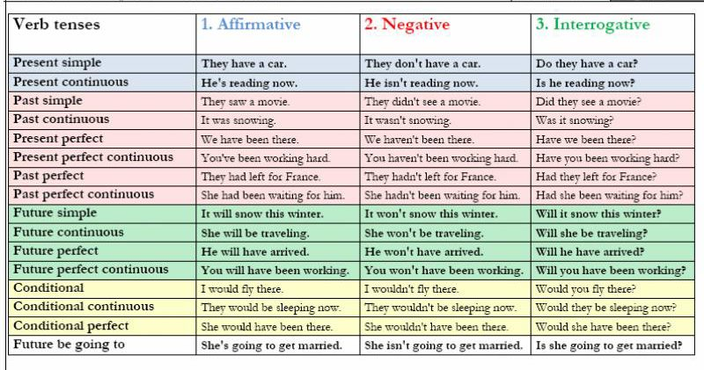

Slide 44
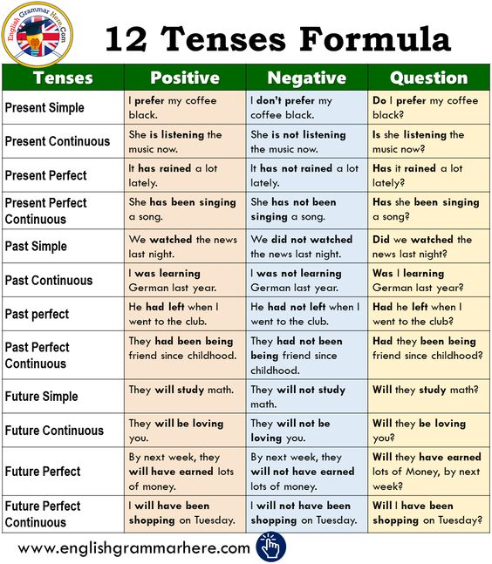

Slide 45
Identify the tense for the following sentences.
My cousin is leaving tomorrow. I have never seen him in a passive mood. I did not concentrate on my studies. The president will be talking to us tomorrow. I shall have finished my writing by then.

Slide 46
Answers
My cousin is leaving tomorrow. – Present Continuous Tense
I have never seen him in a passive mood. – Present perfect tense
I did not concentrate on my studies. – Simple Past Tense
The president will be talking to us tomorrow. – Future Continuous Tense
I shall have finished my writing by then. – Future Perfect Tense

Slide 47
Identify the tense in the given sentences.
I will be studying English when you arrive tonight.
2. I have studied English in several different countries.
3. I had studied a little English before I moved to the U.S
4. I will have studied every tense by the time I finish this course.
5. I had been studying English for five years before I moved to the U.S.
6. I will have been studying English for over two hours by the time you arrive.

Slide 48
Change the following sentences into other tenses as given in the brocket.
1. | She has chosen blue curtains for room. (into Past Perfect tense)
2. | She will go out for dinner this evening. (Future Continues tense)
3. | The helicopter will be landing at 6 am this morning. (into Simple Future tense)
4. | We knew about his plan. (into Simple Present tense)
5. | I haven’t got the keys to the stores. (into past perfect tense)
6. | I speak French. (into present continuous tense) Why are the kids sleeping? (into past continuous tense)
7. | We will eat in ten minutes. (into future continuous tense)
8. | He is studying to become a dentist. (into past continuous tense)

Slide 49
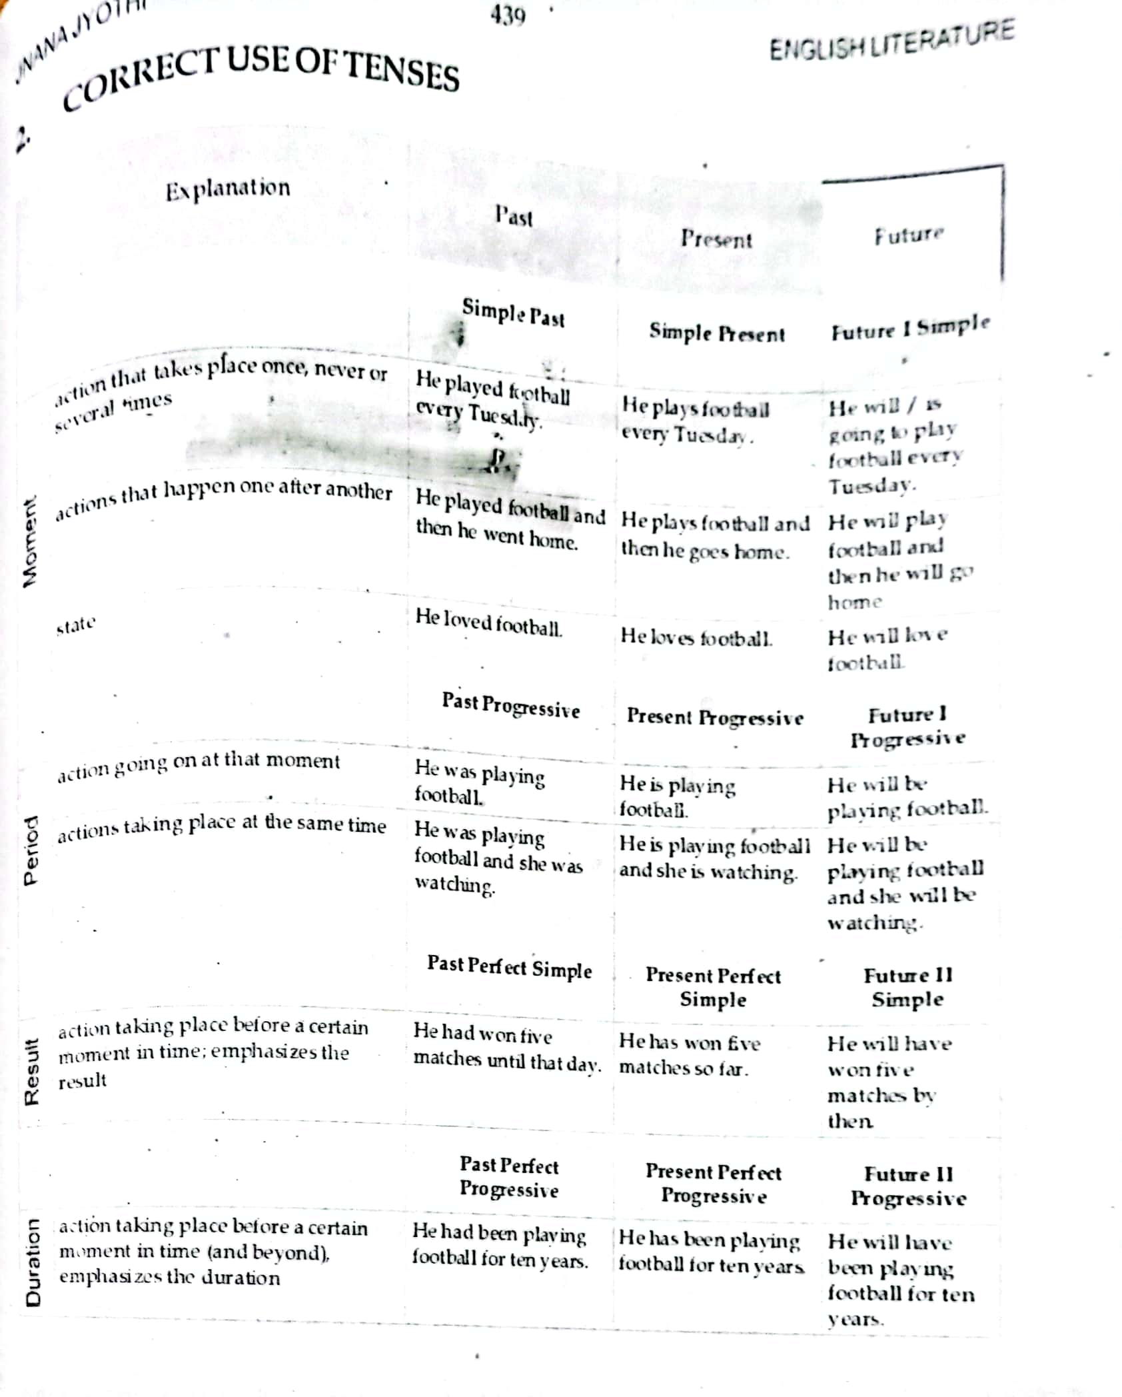

Slide 50
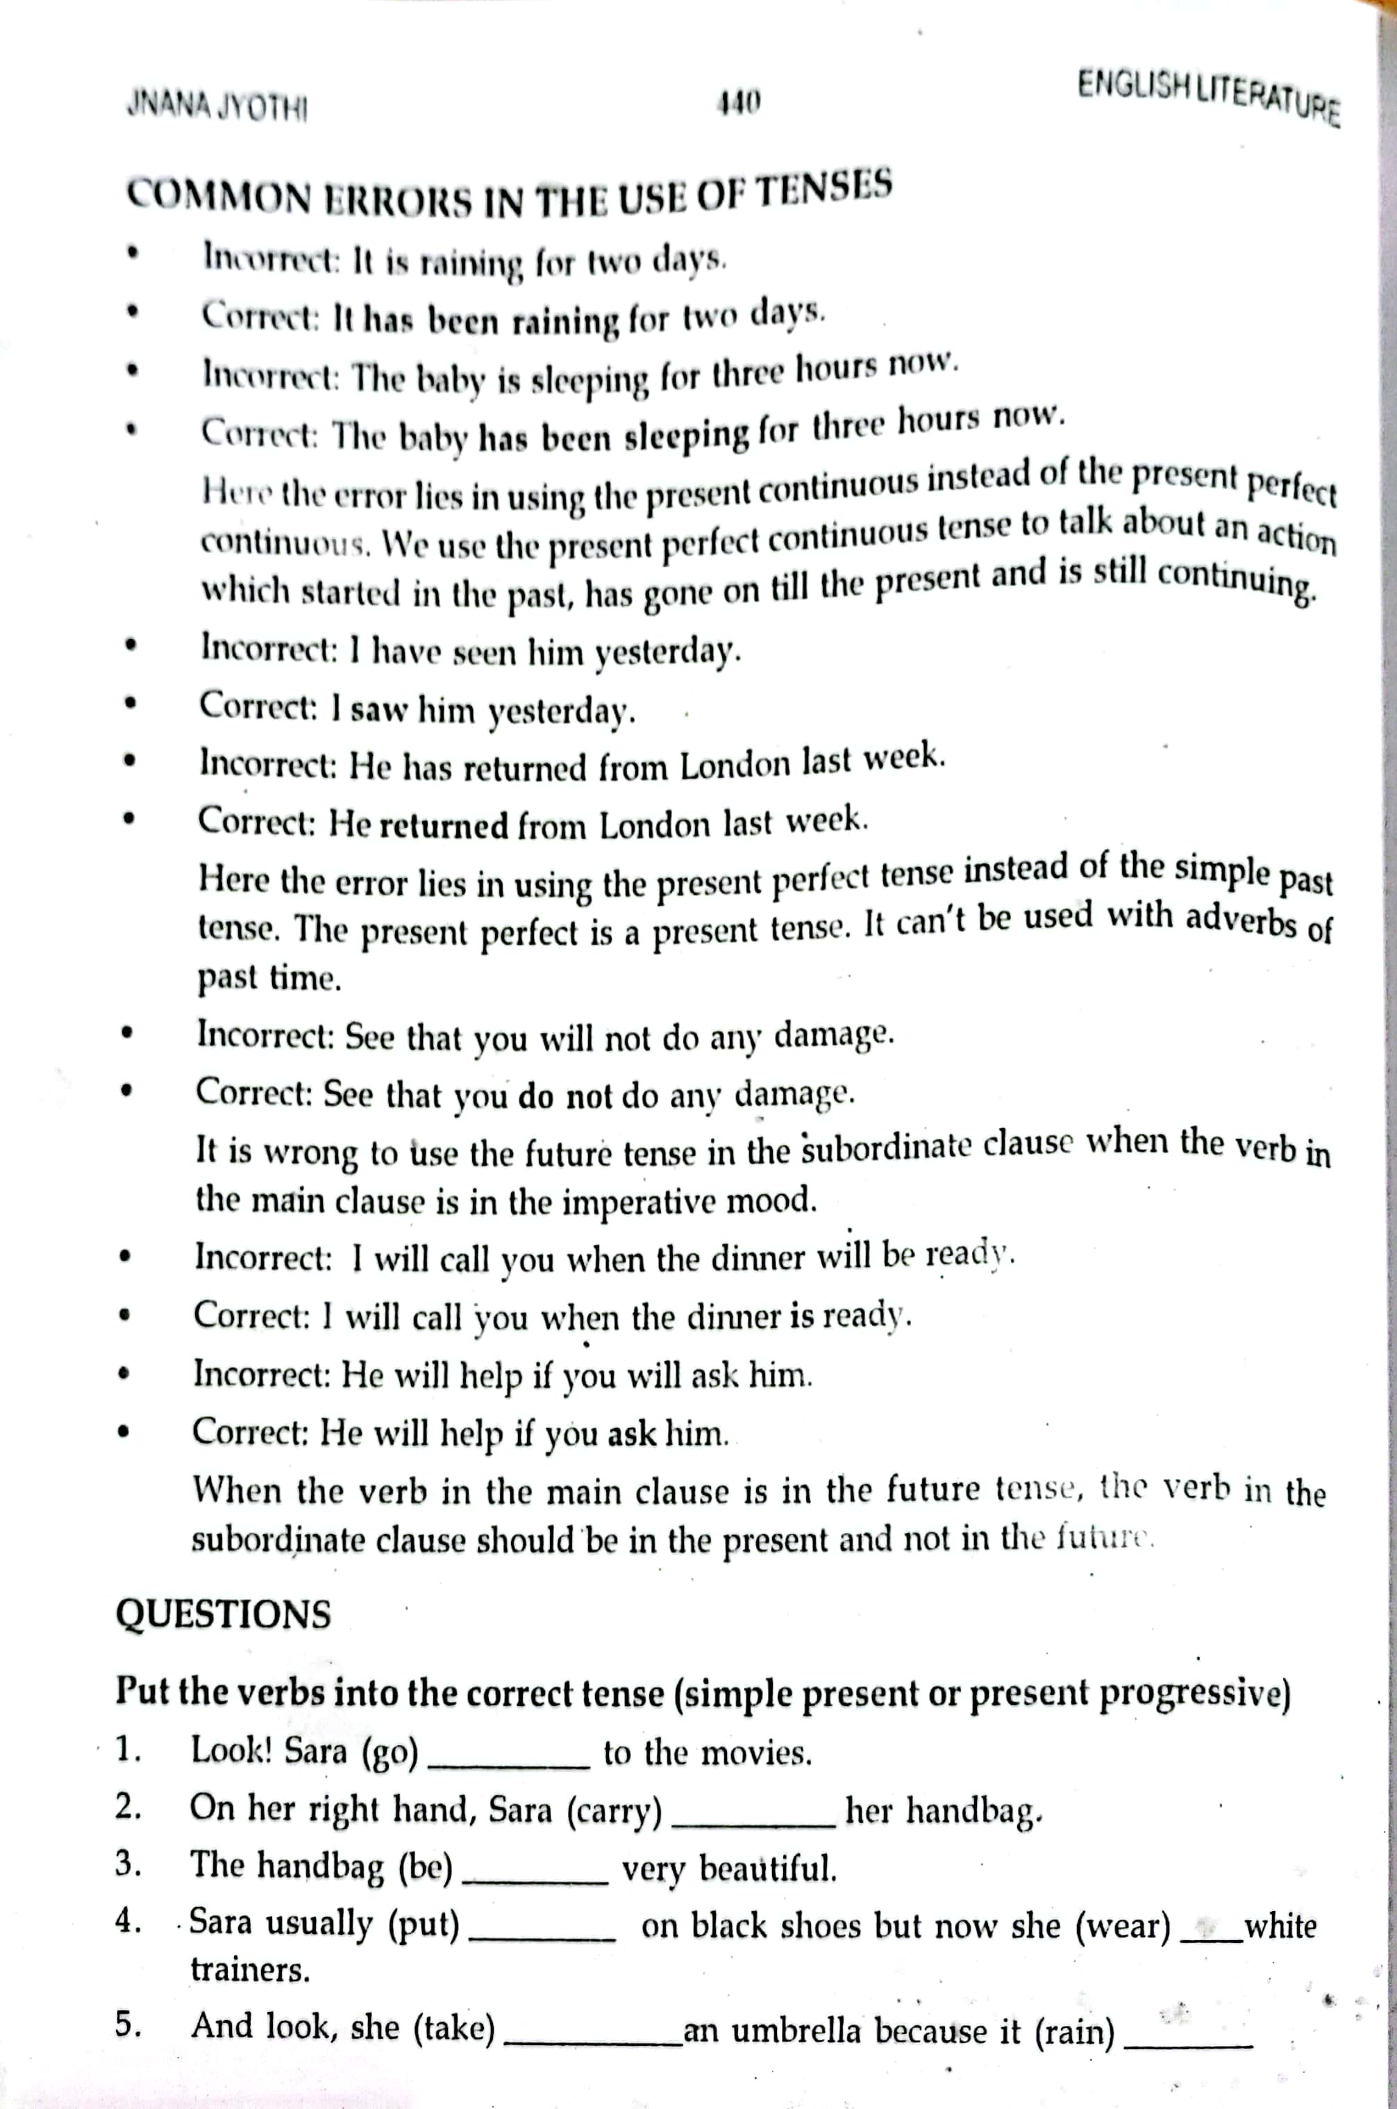

Slide 51
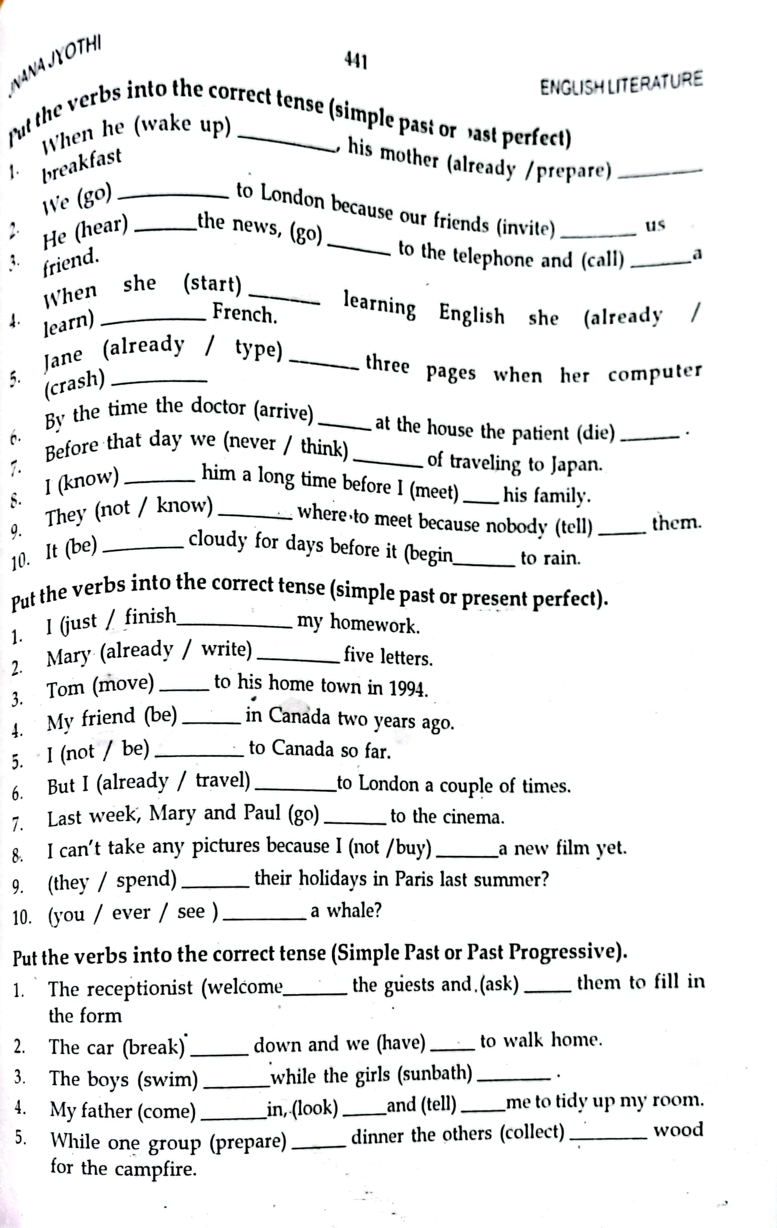

Slide 52
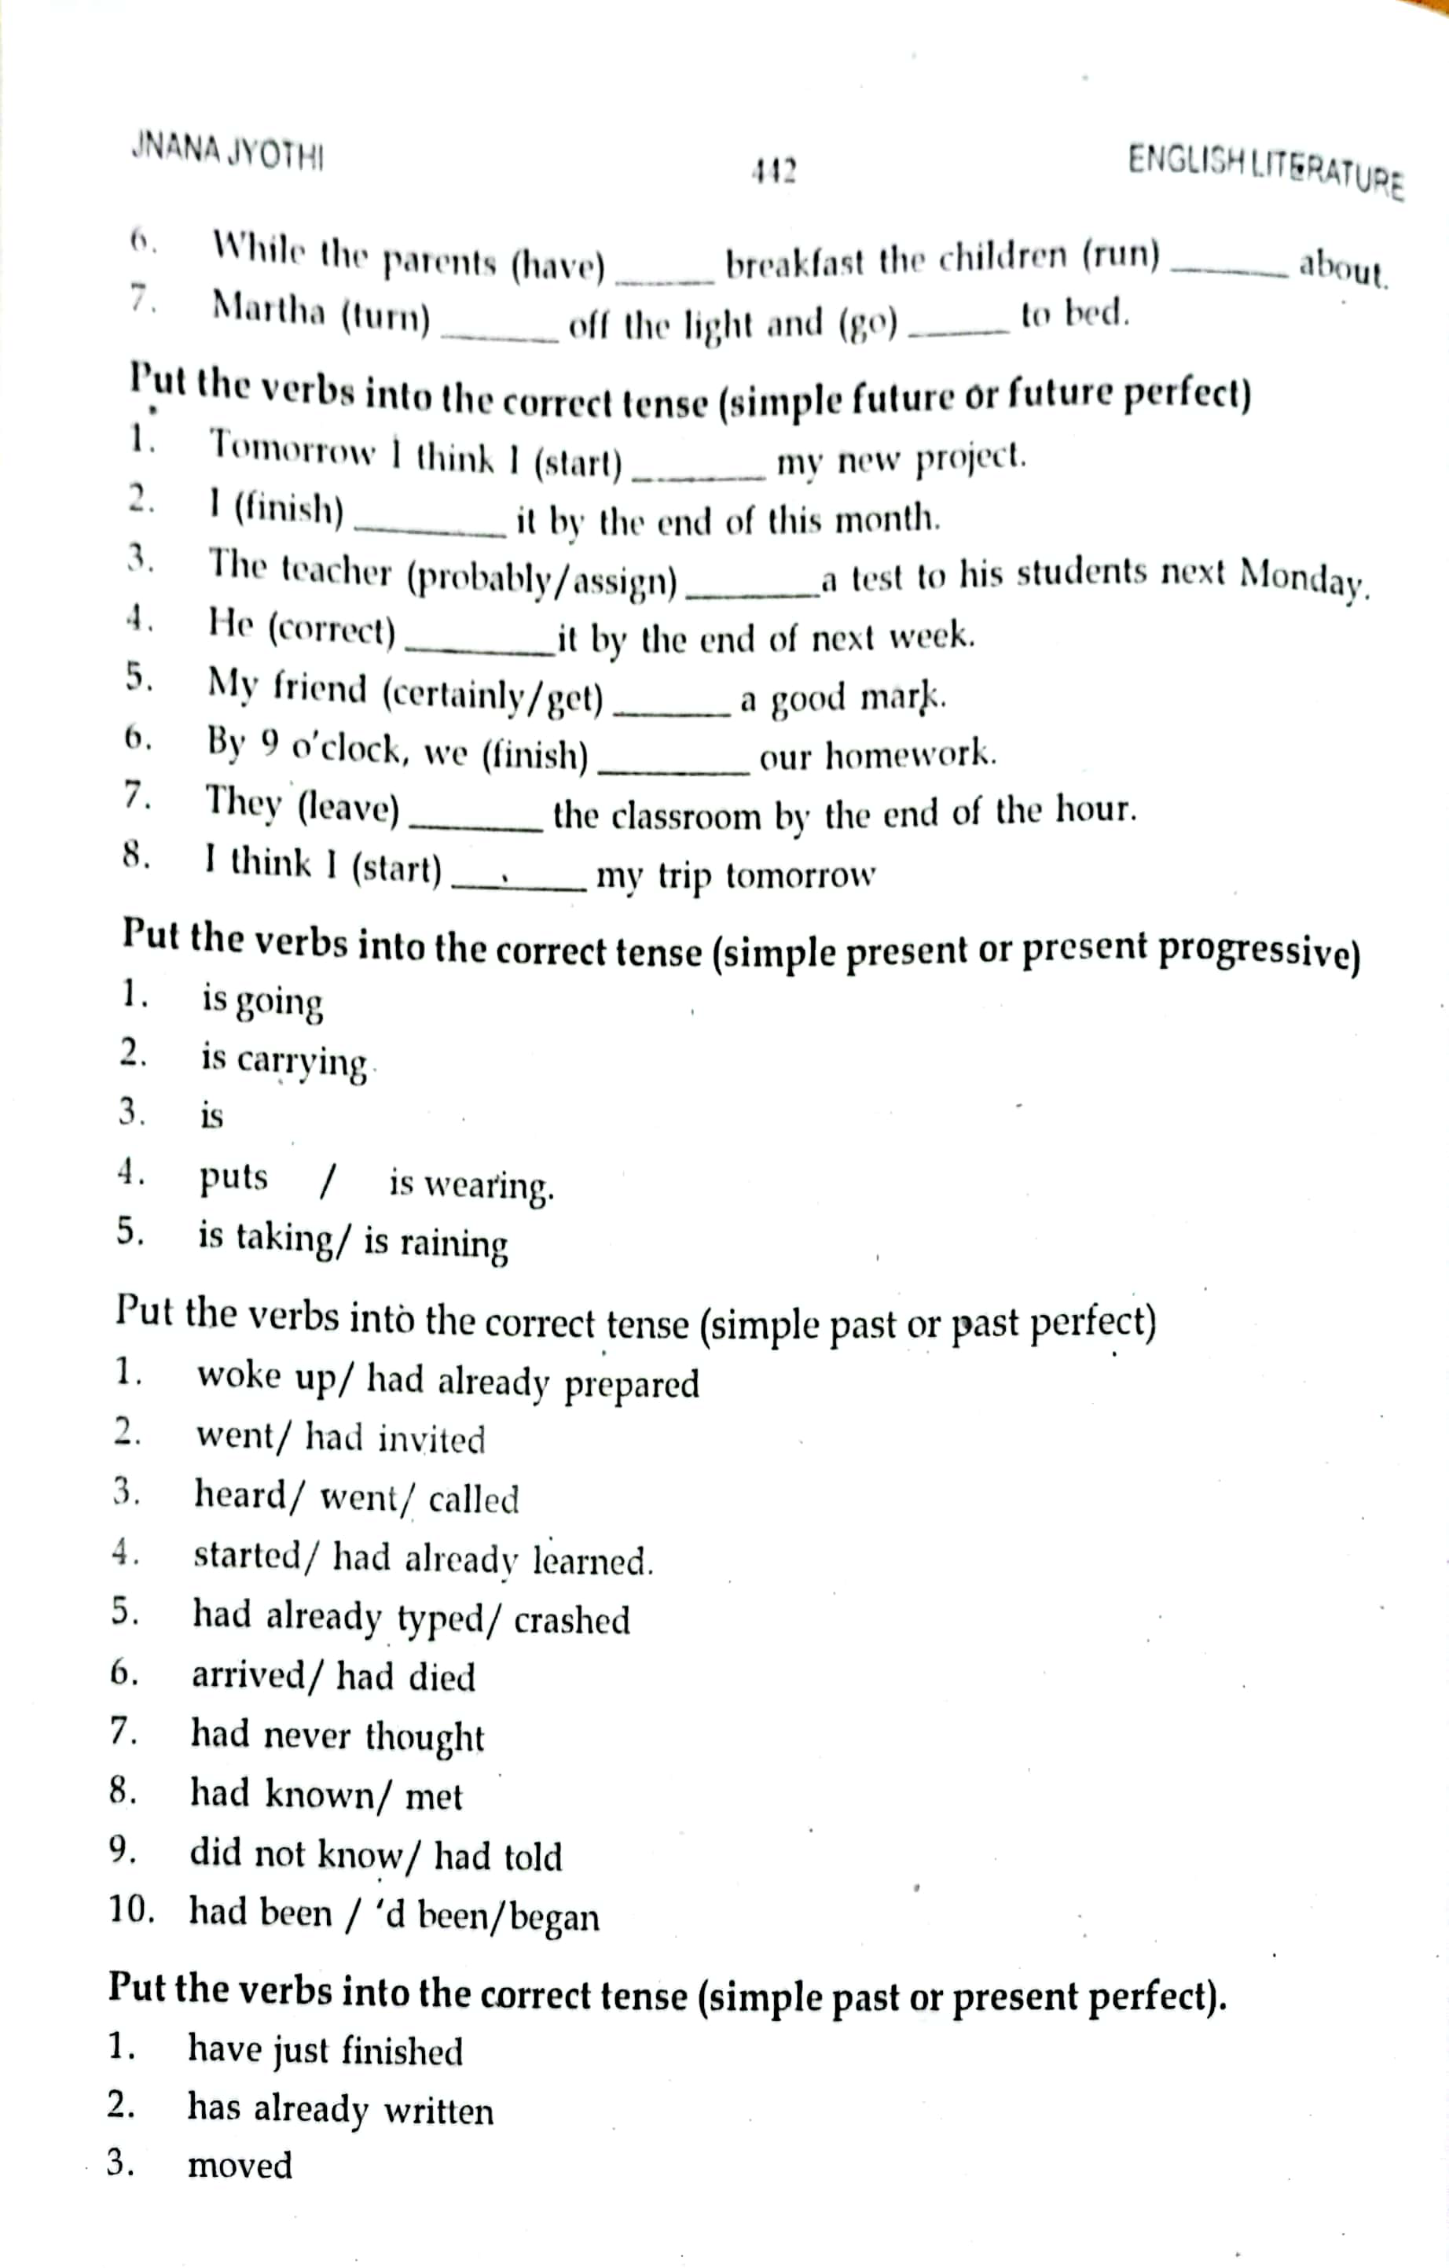

Slide 53
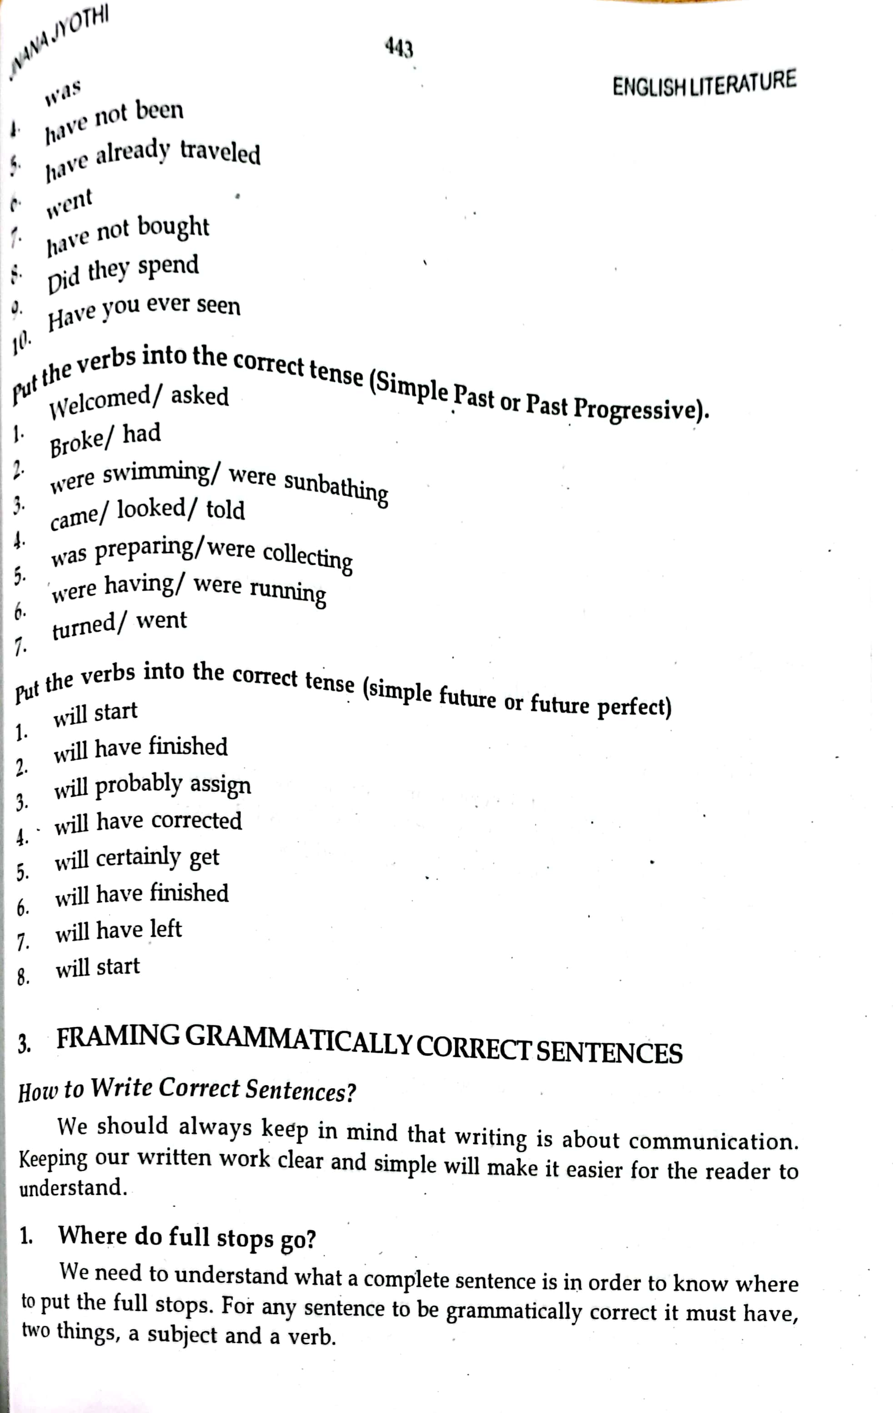

Slide 54
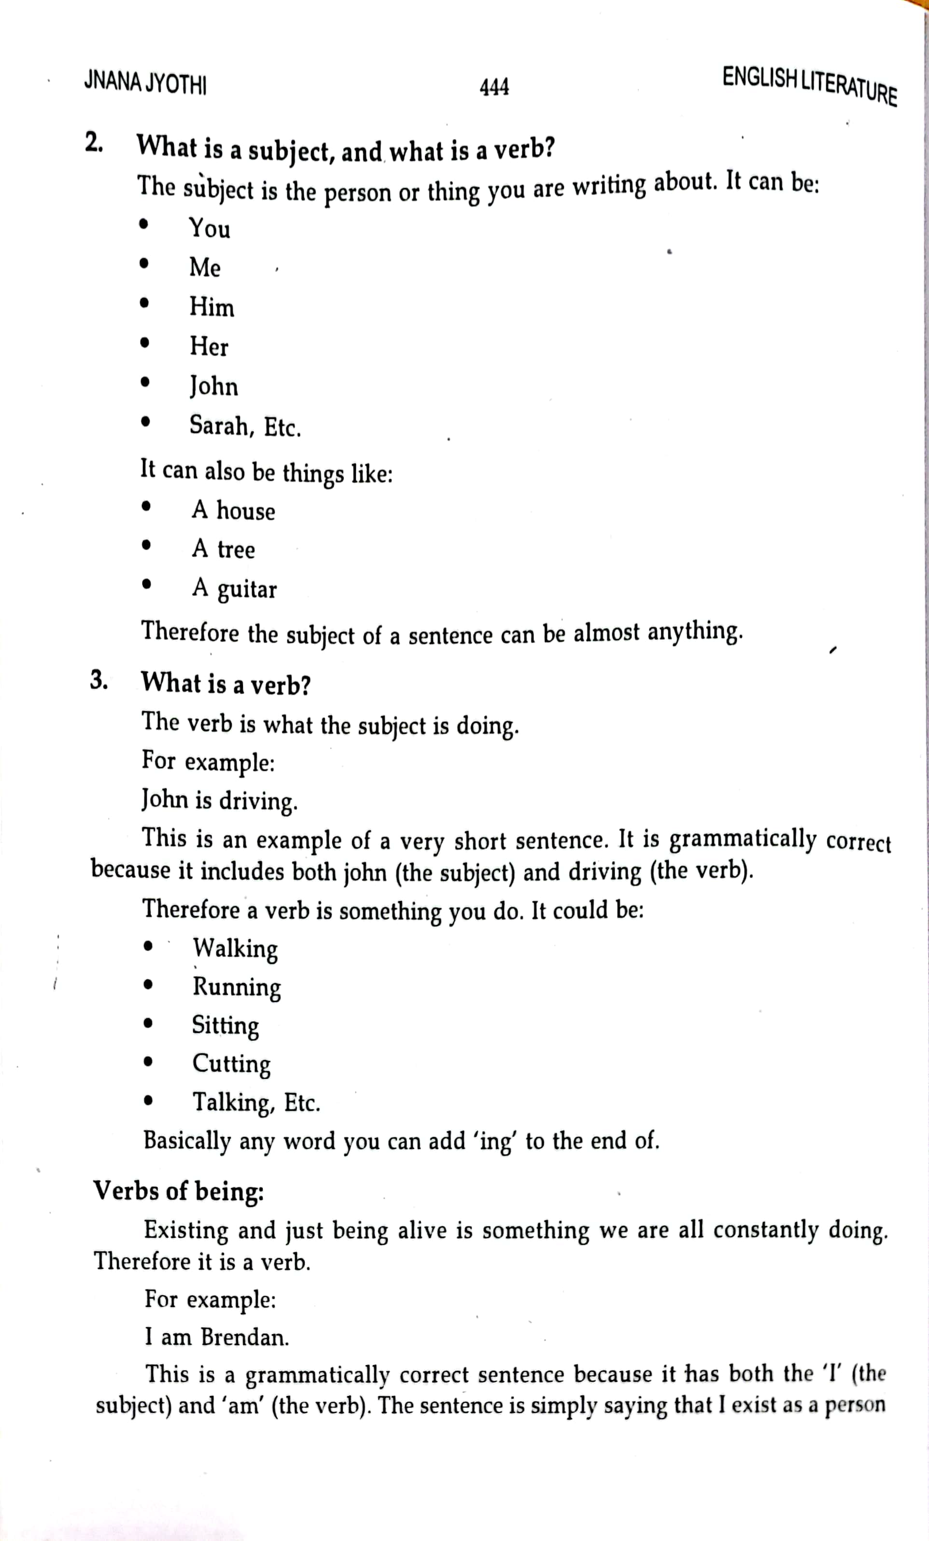

Slide 55
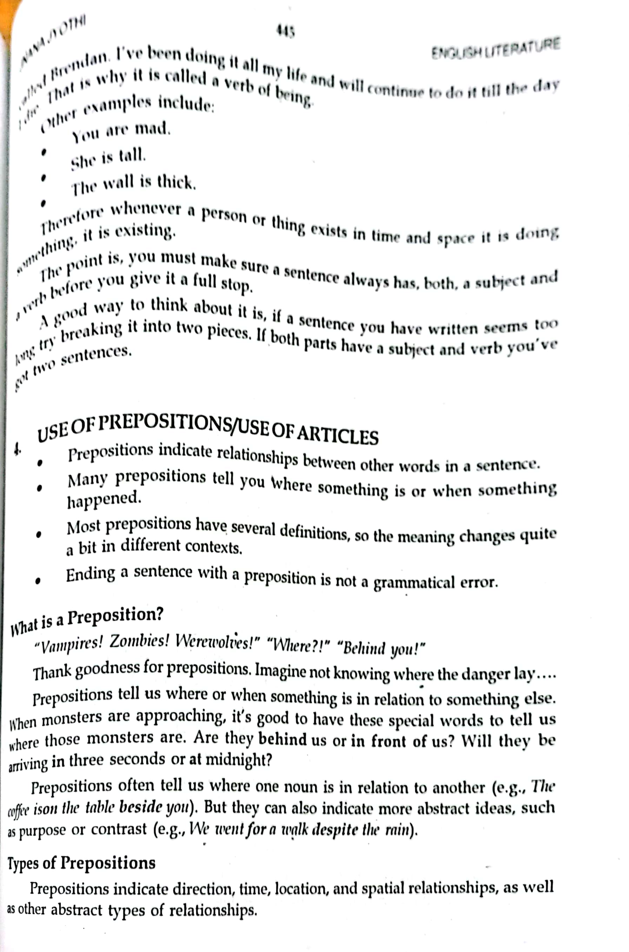

Slide 56
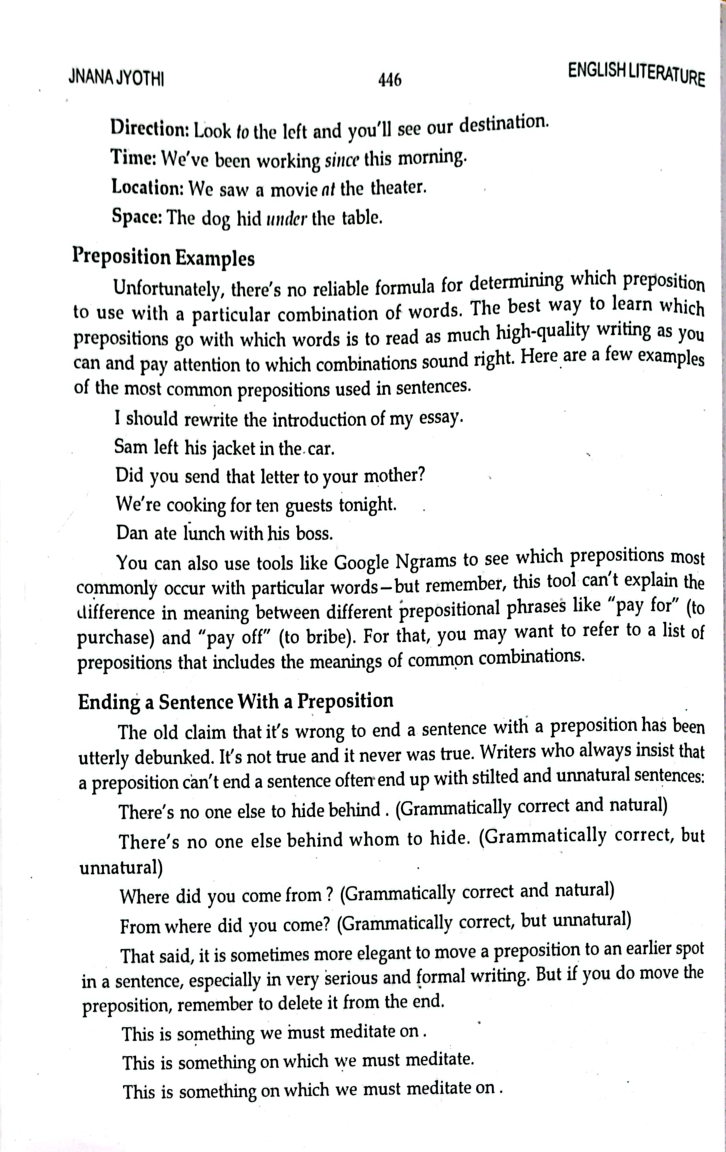

Slide 57
Subject Verb Agreement (Concord rules)

Slide 58
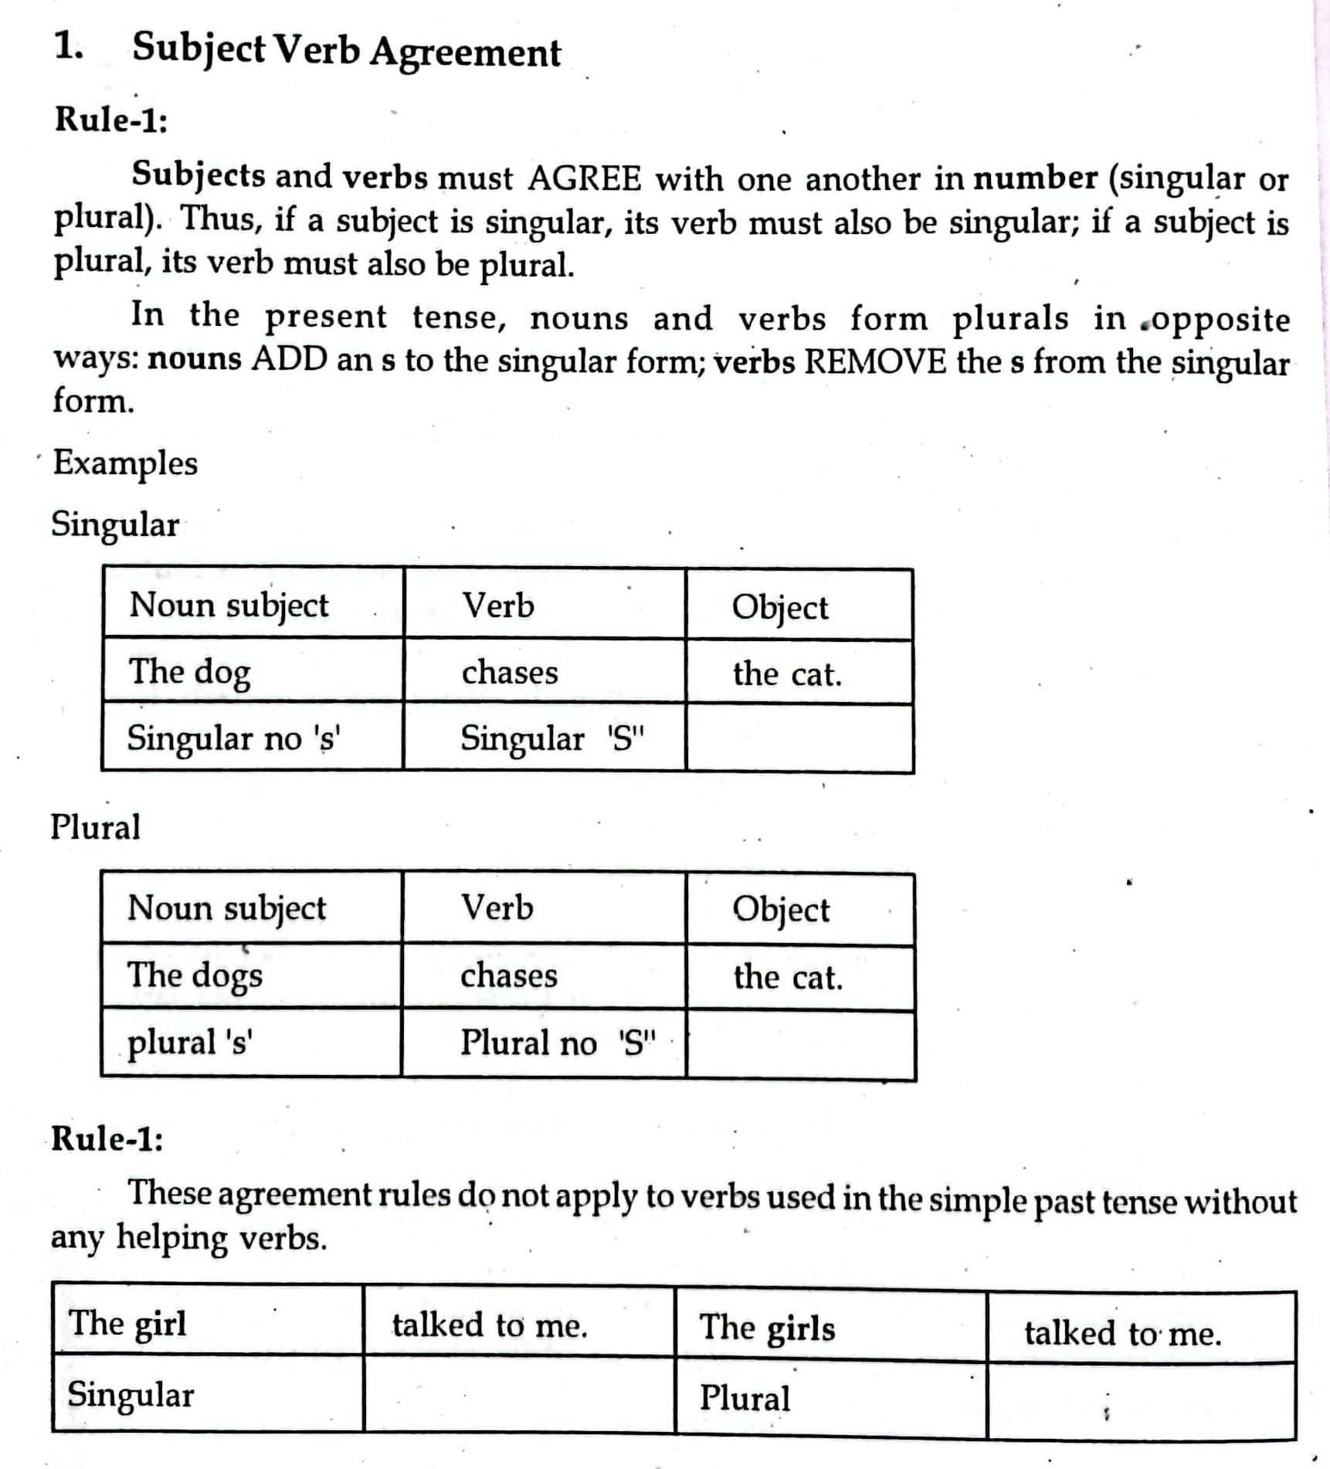

Slide 59
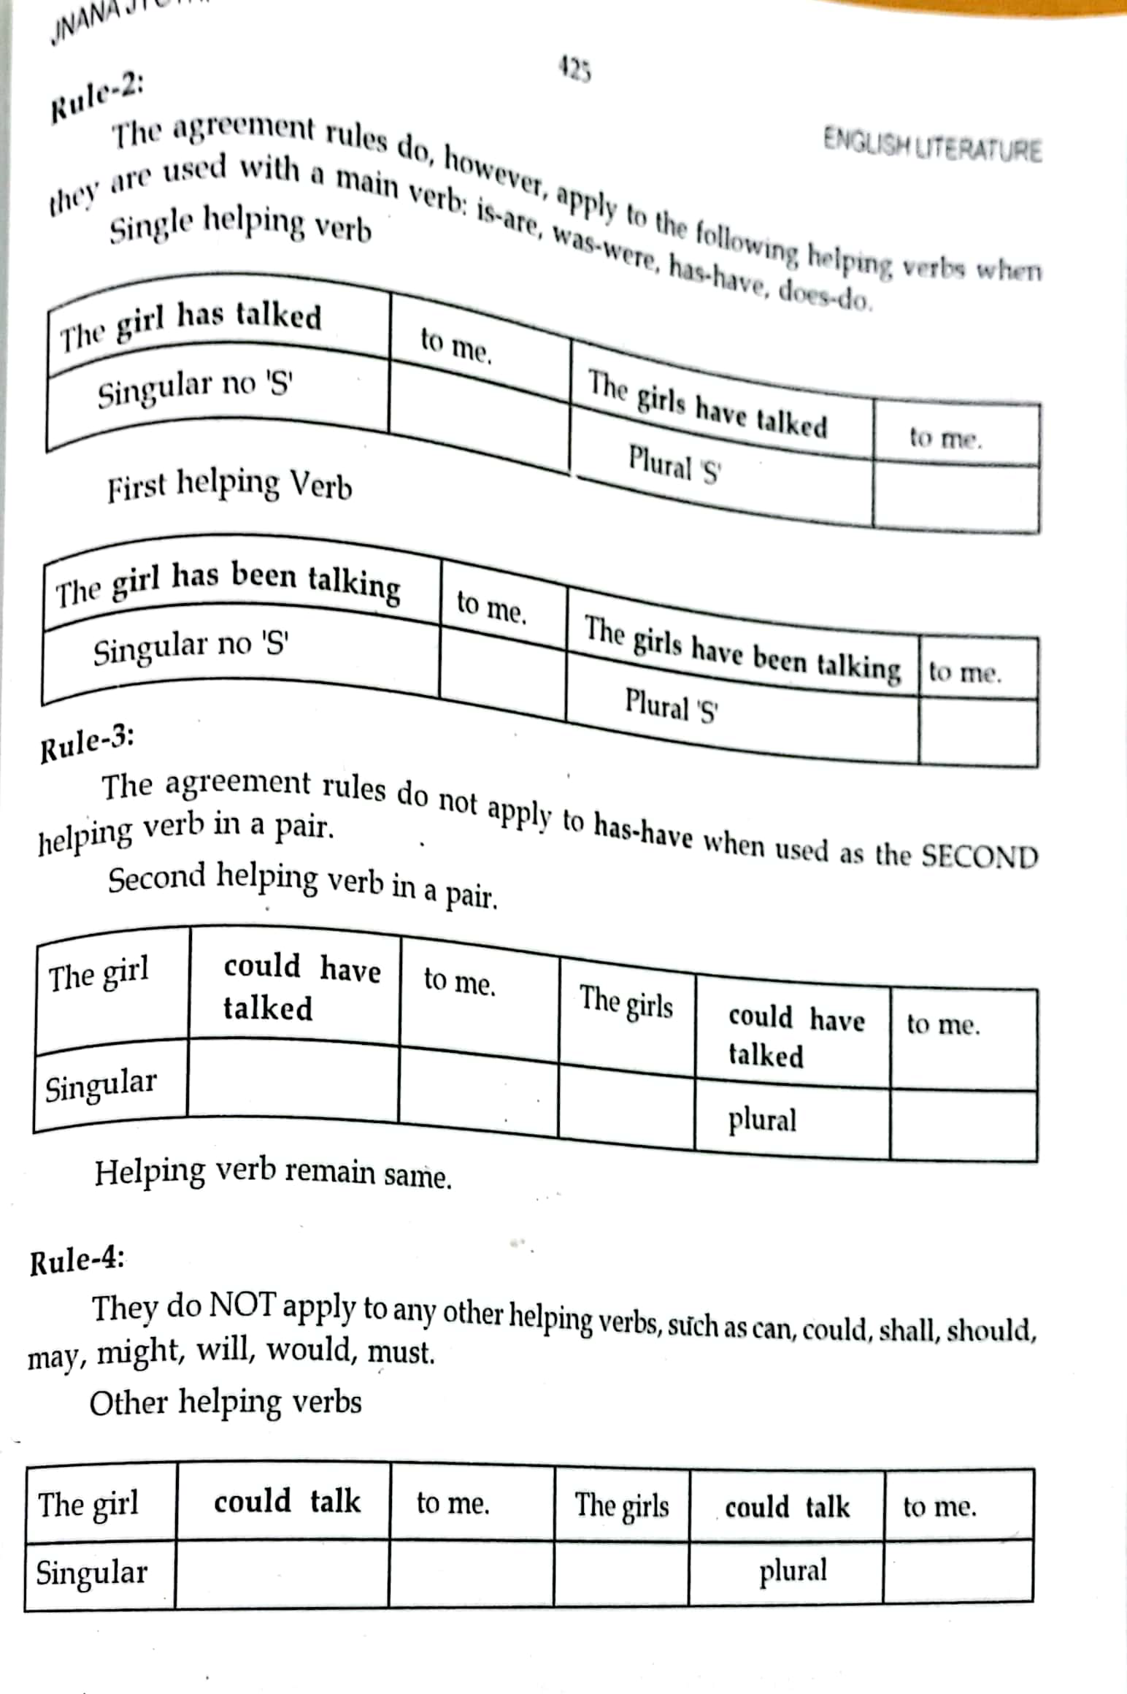

Slide 60
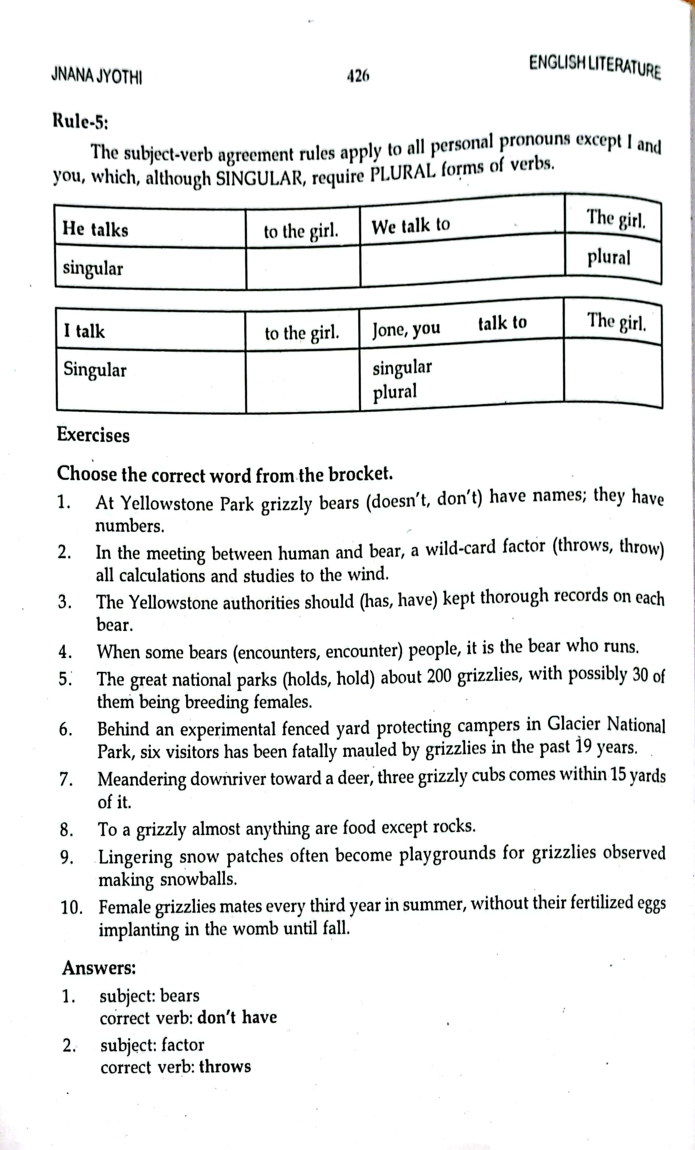

Slide 61
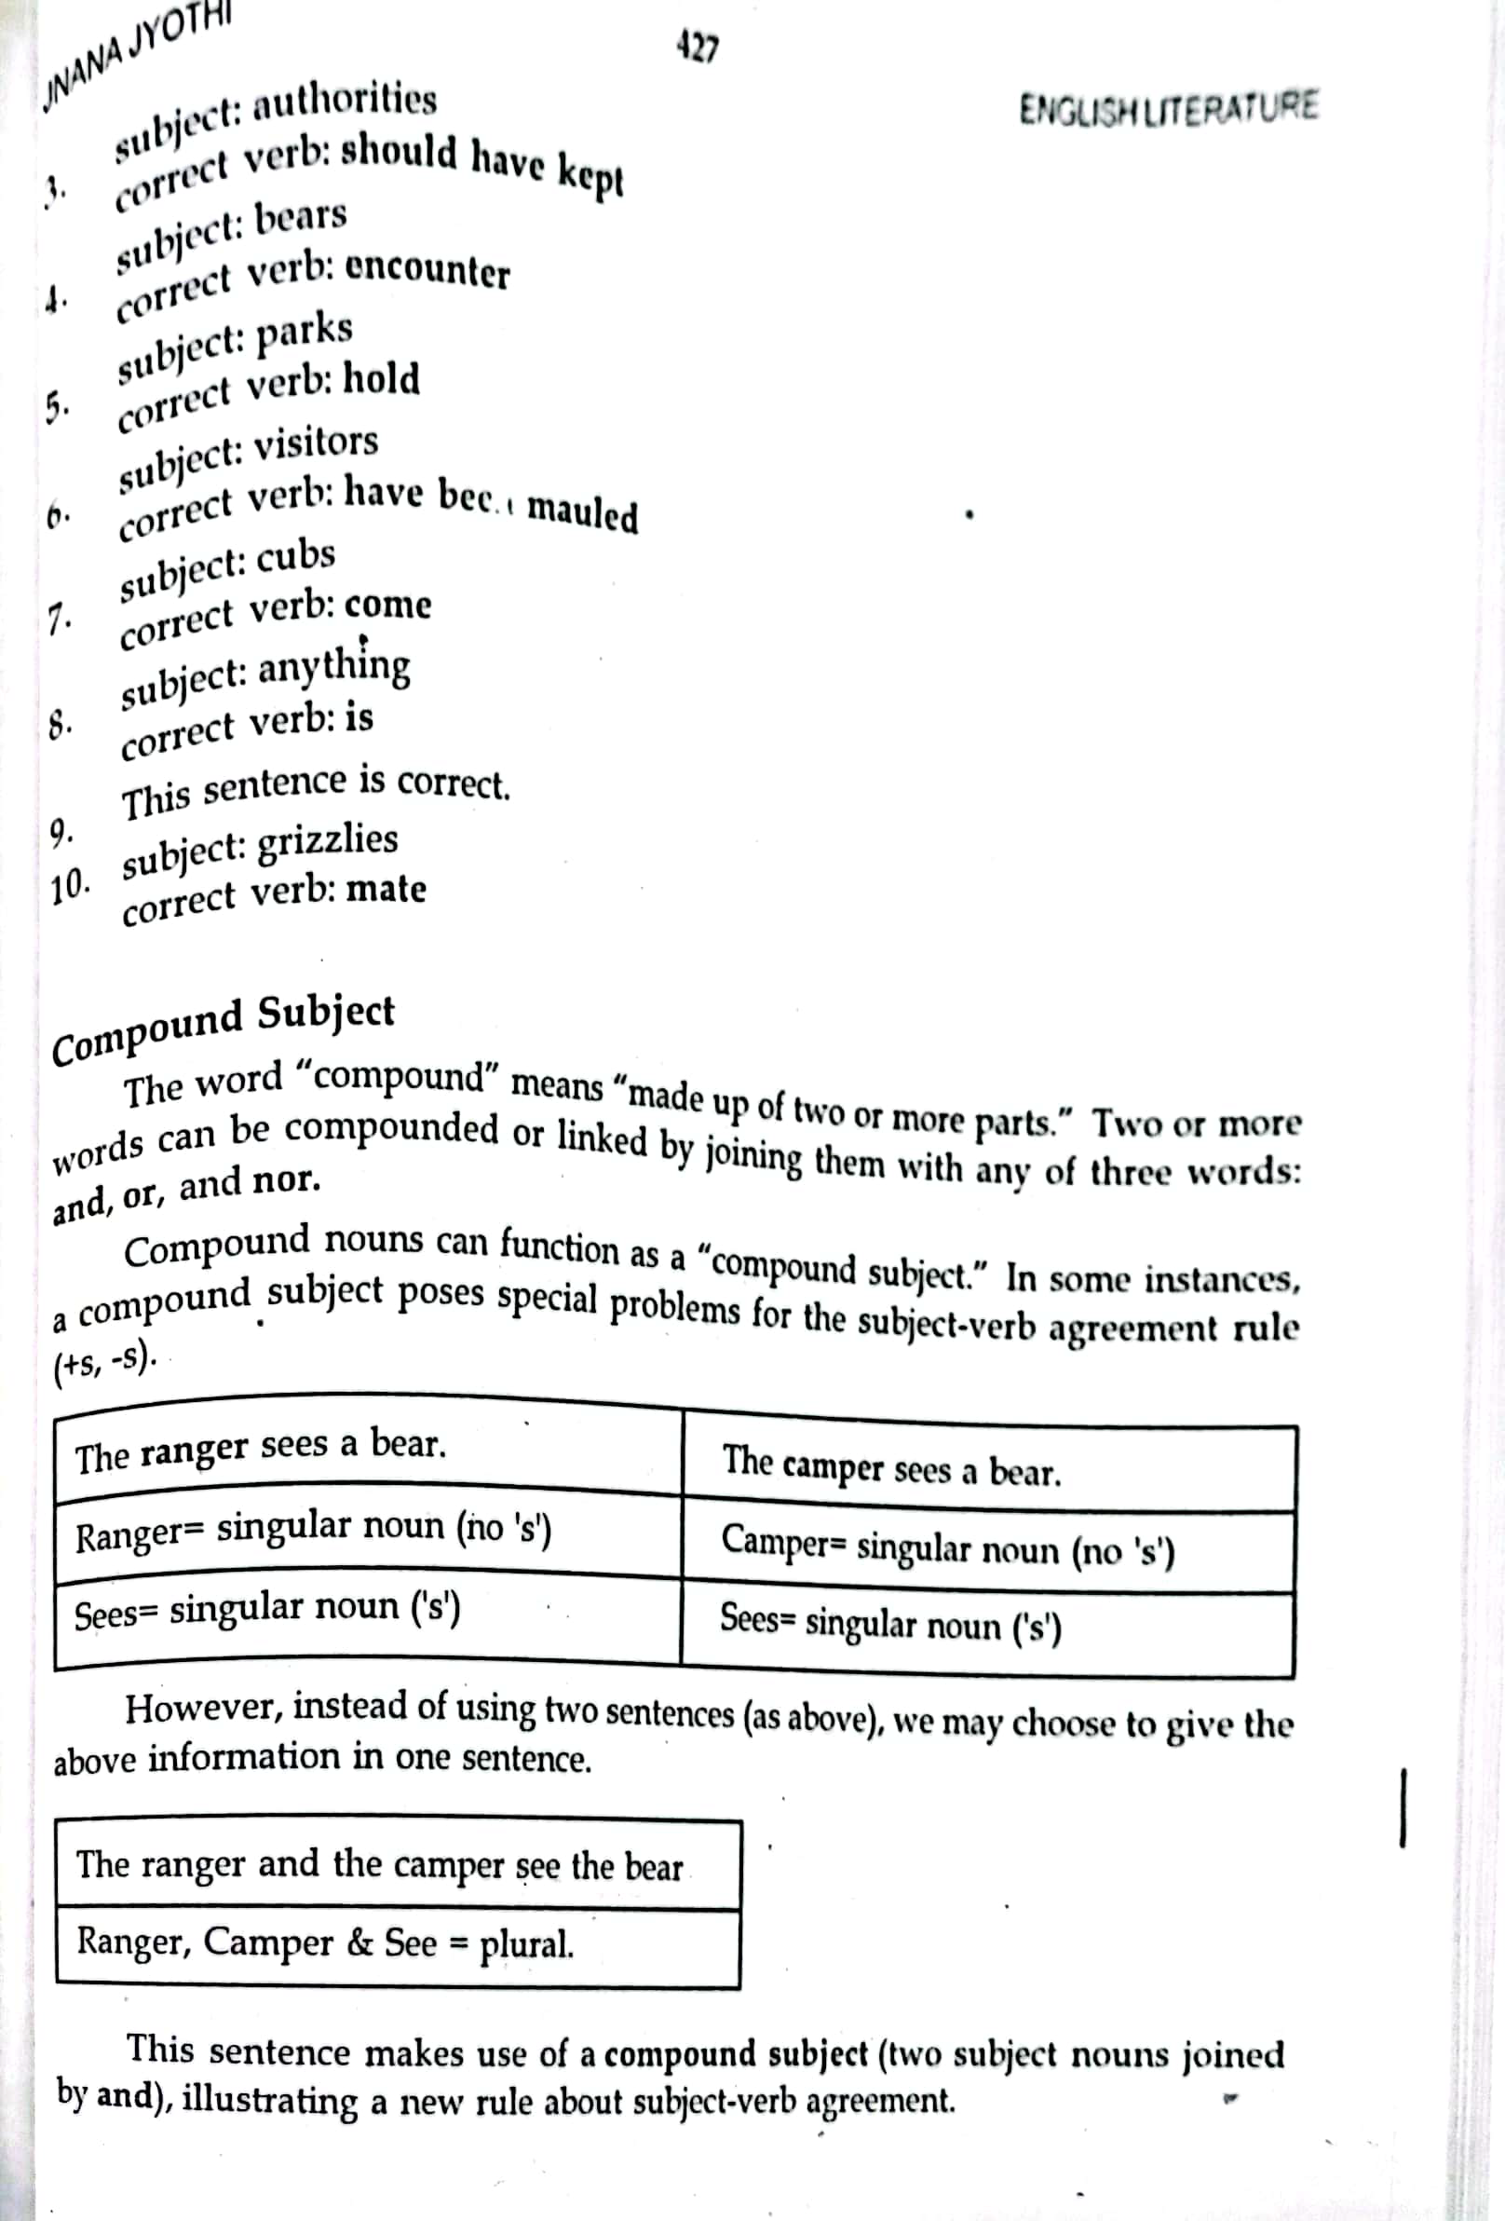

Slide 62
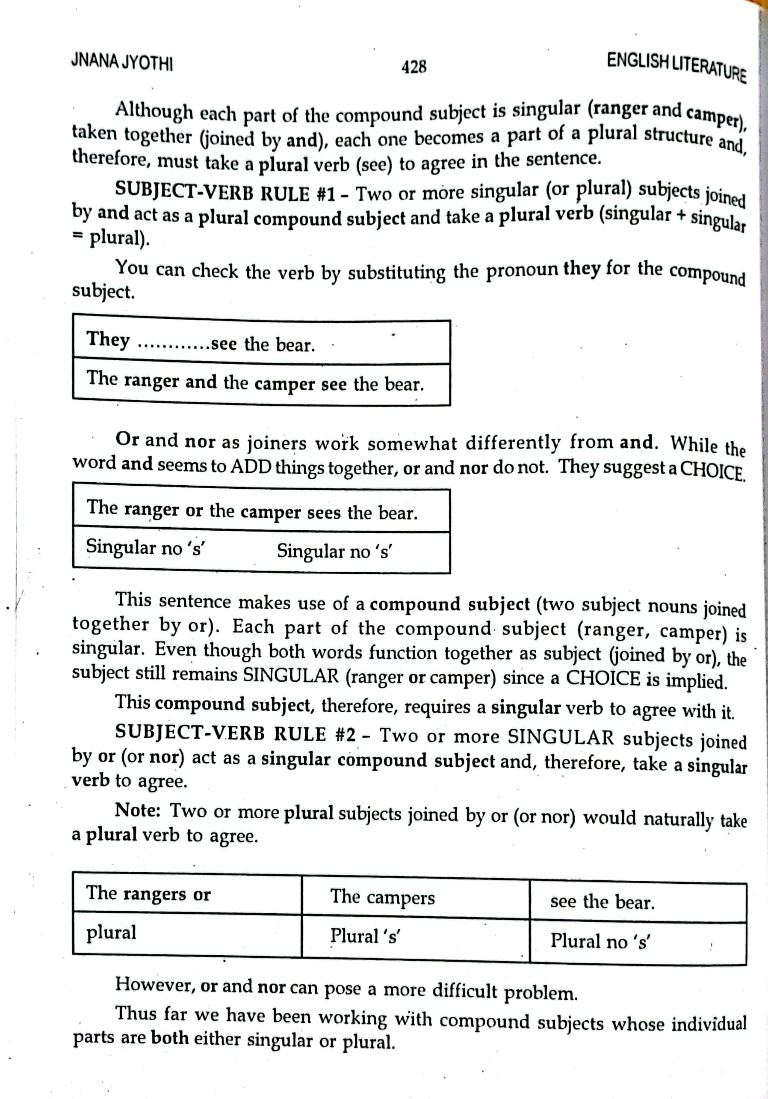

Slide 63
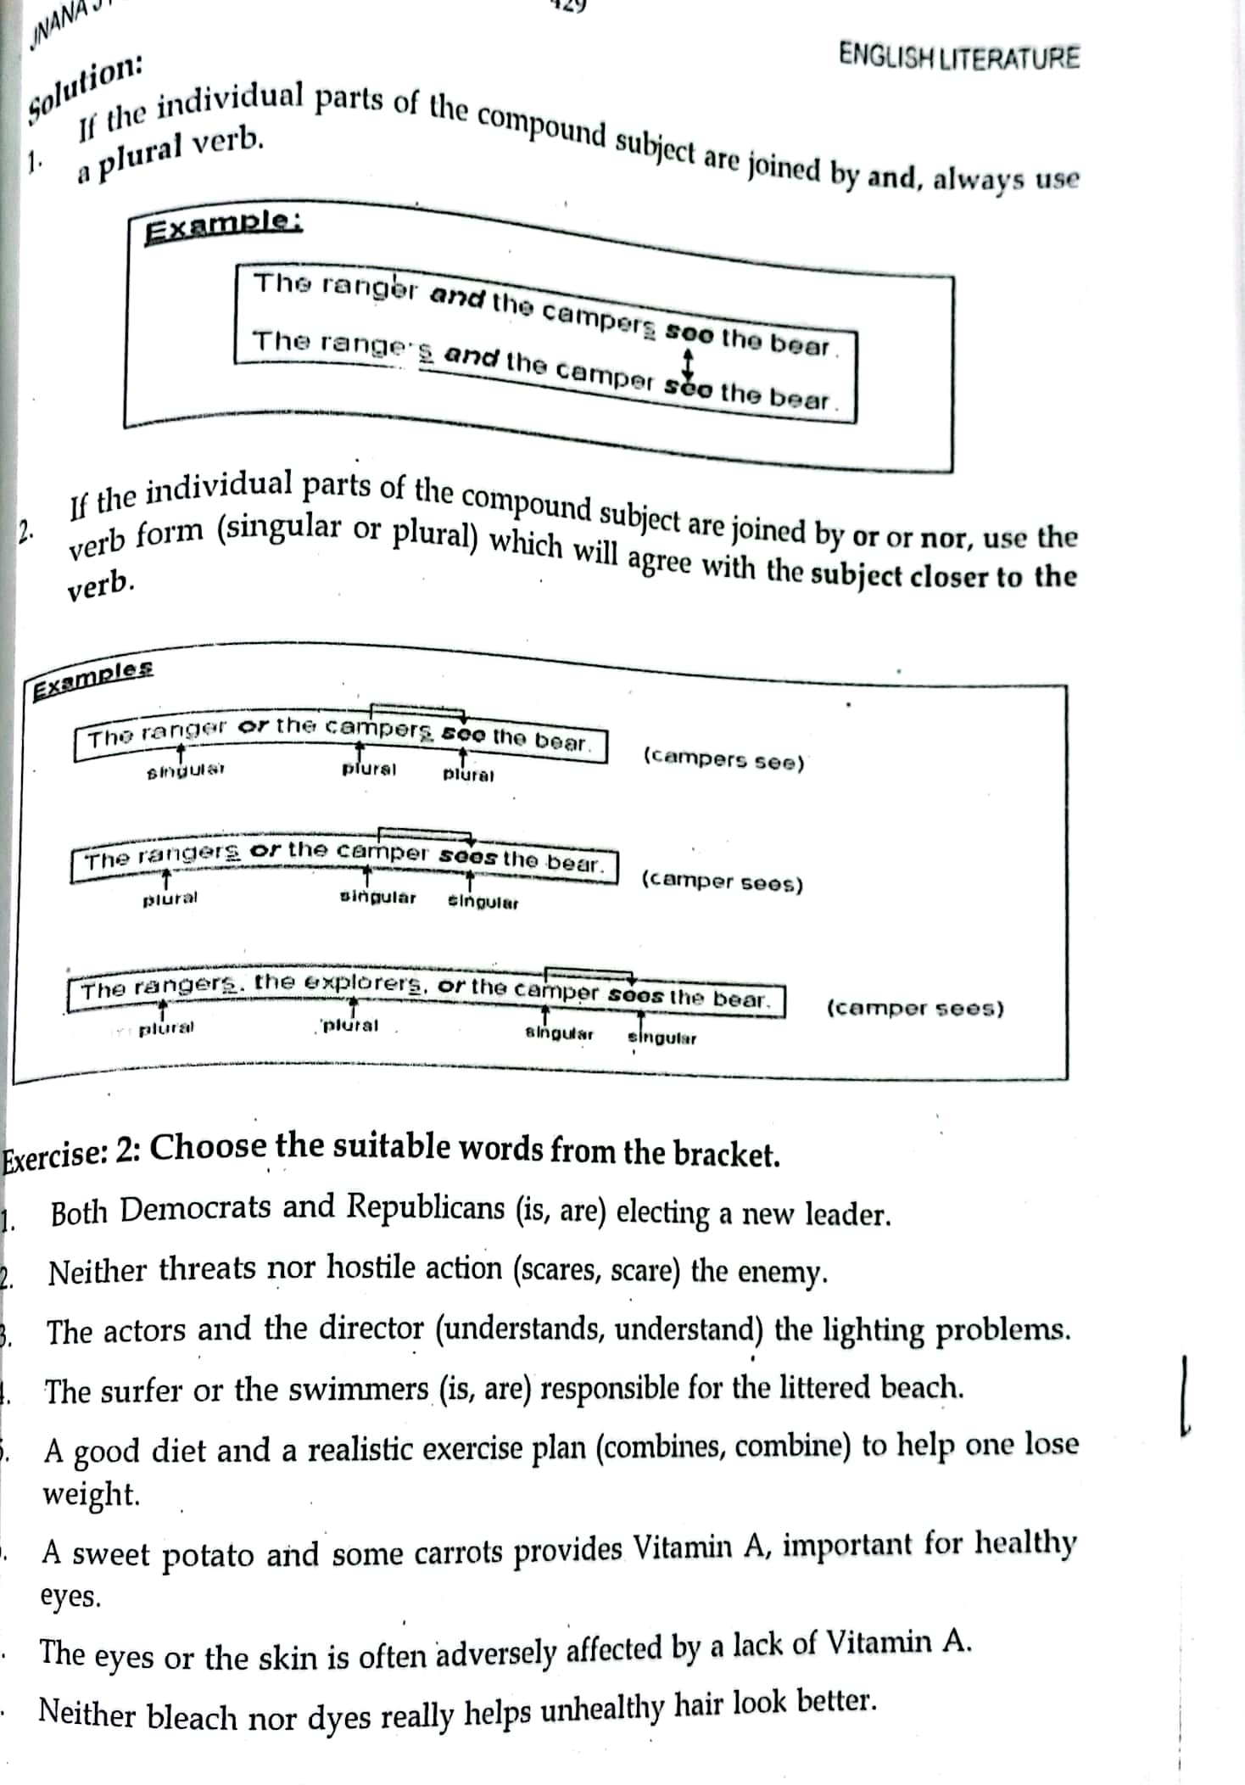

Slide 64
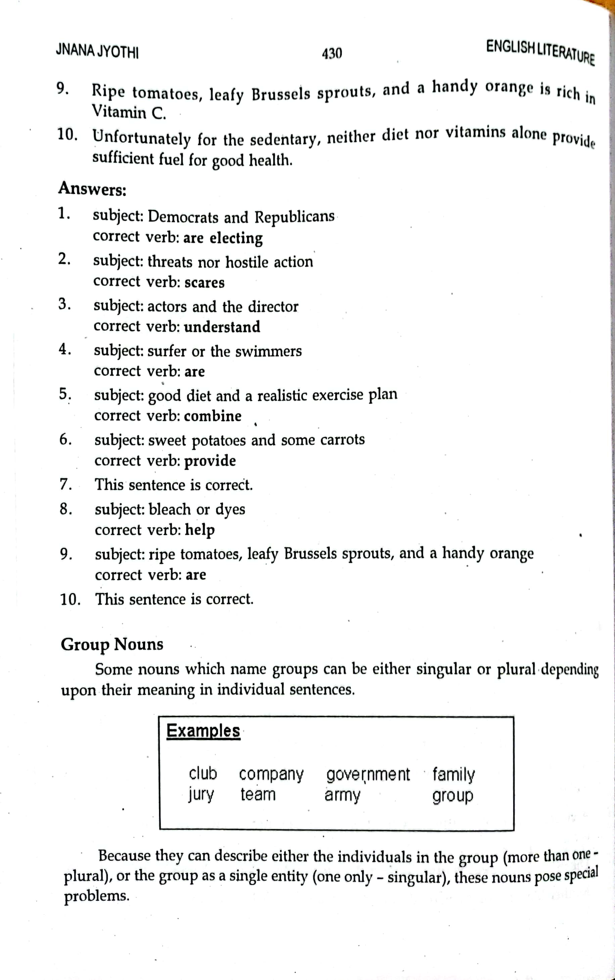

Slide 65
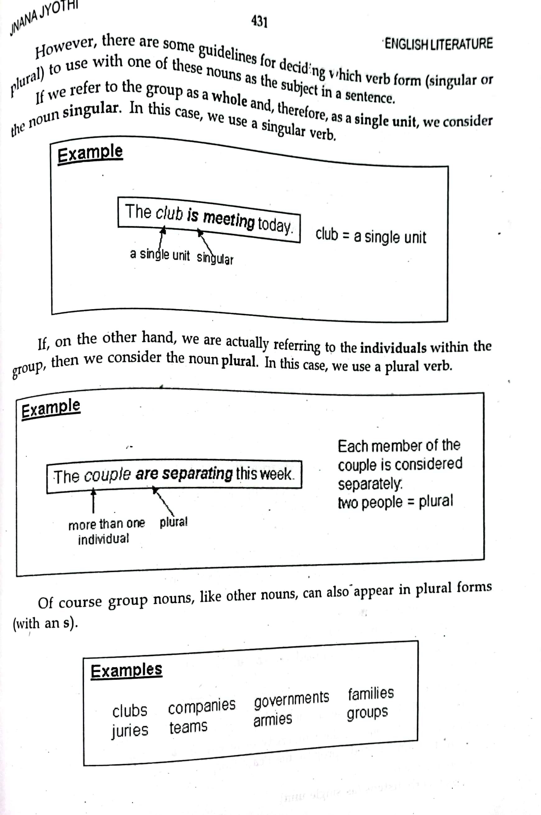

Slide 66
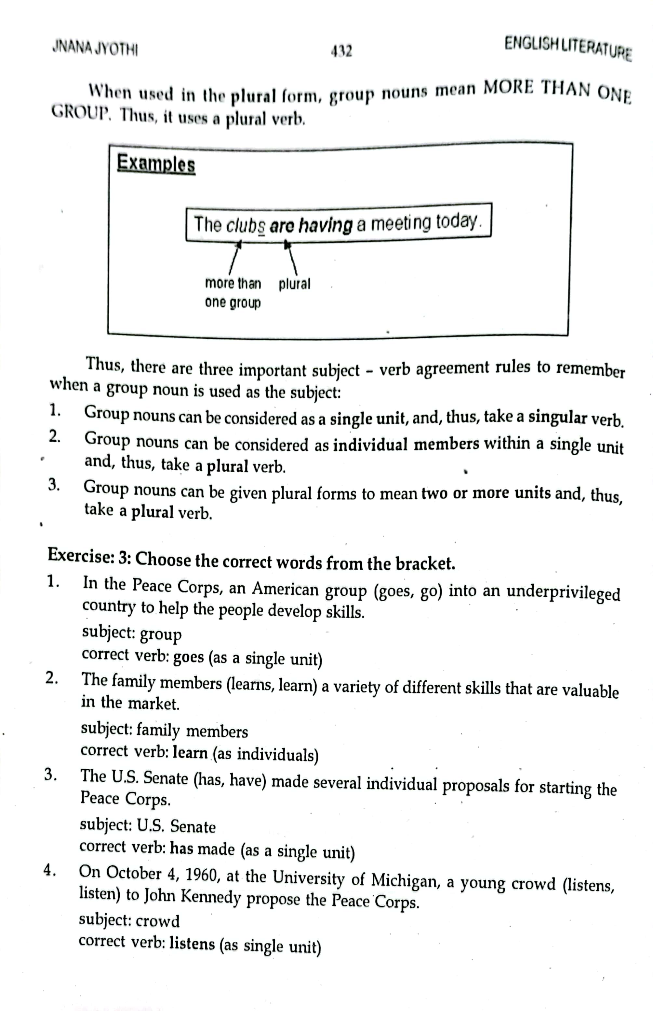

Slide 67
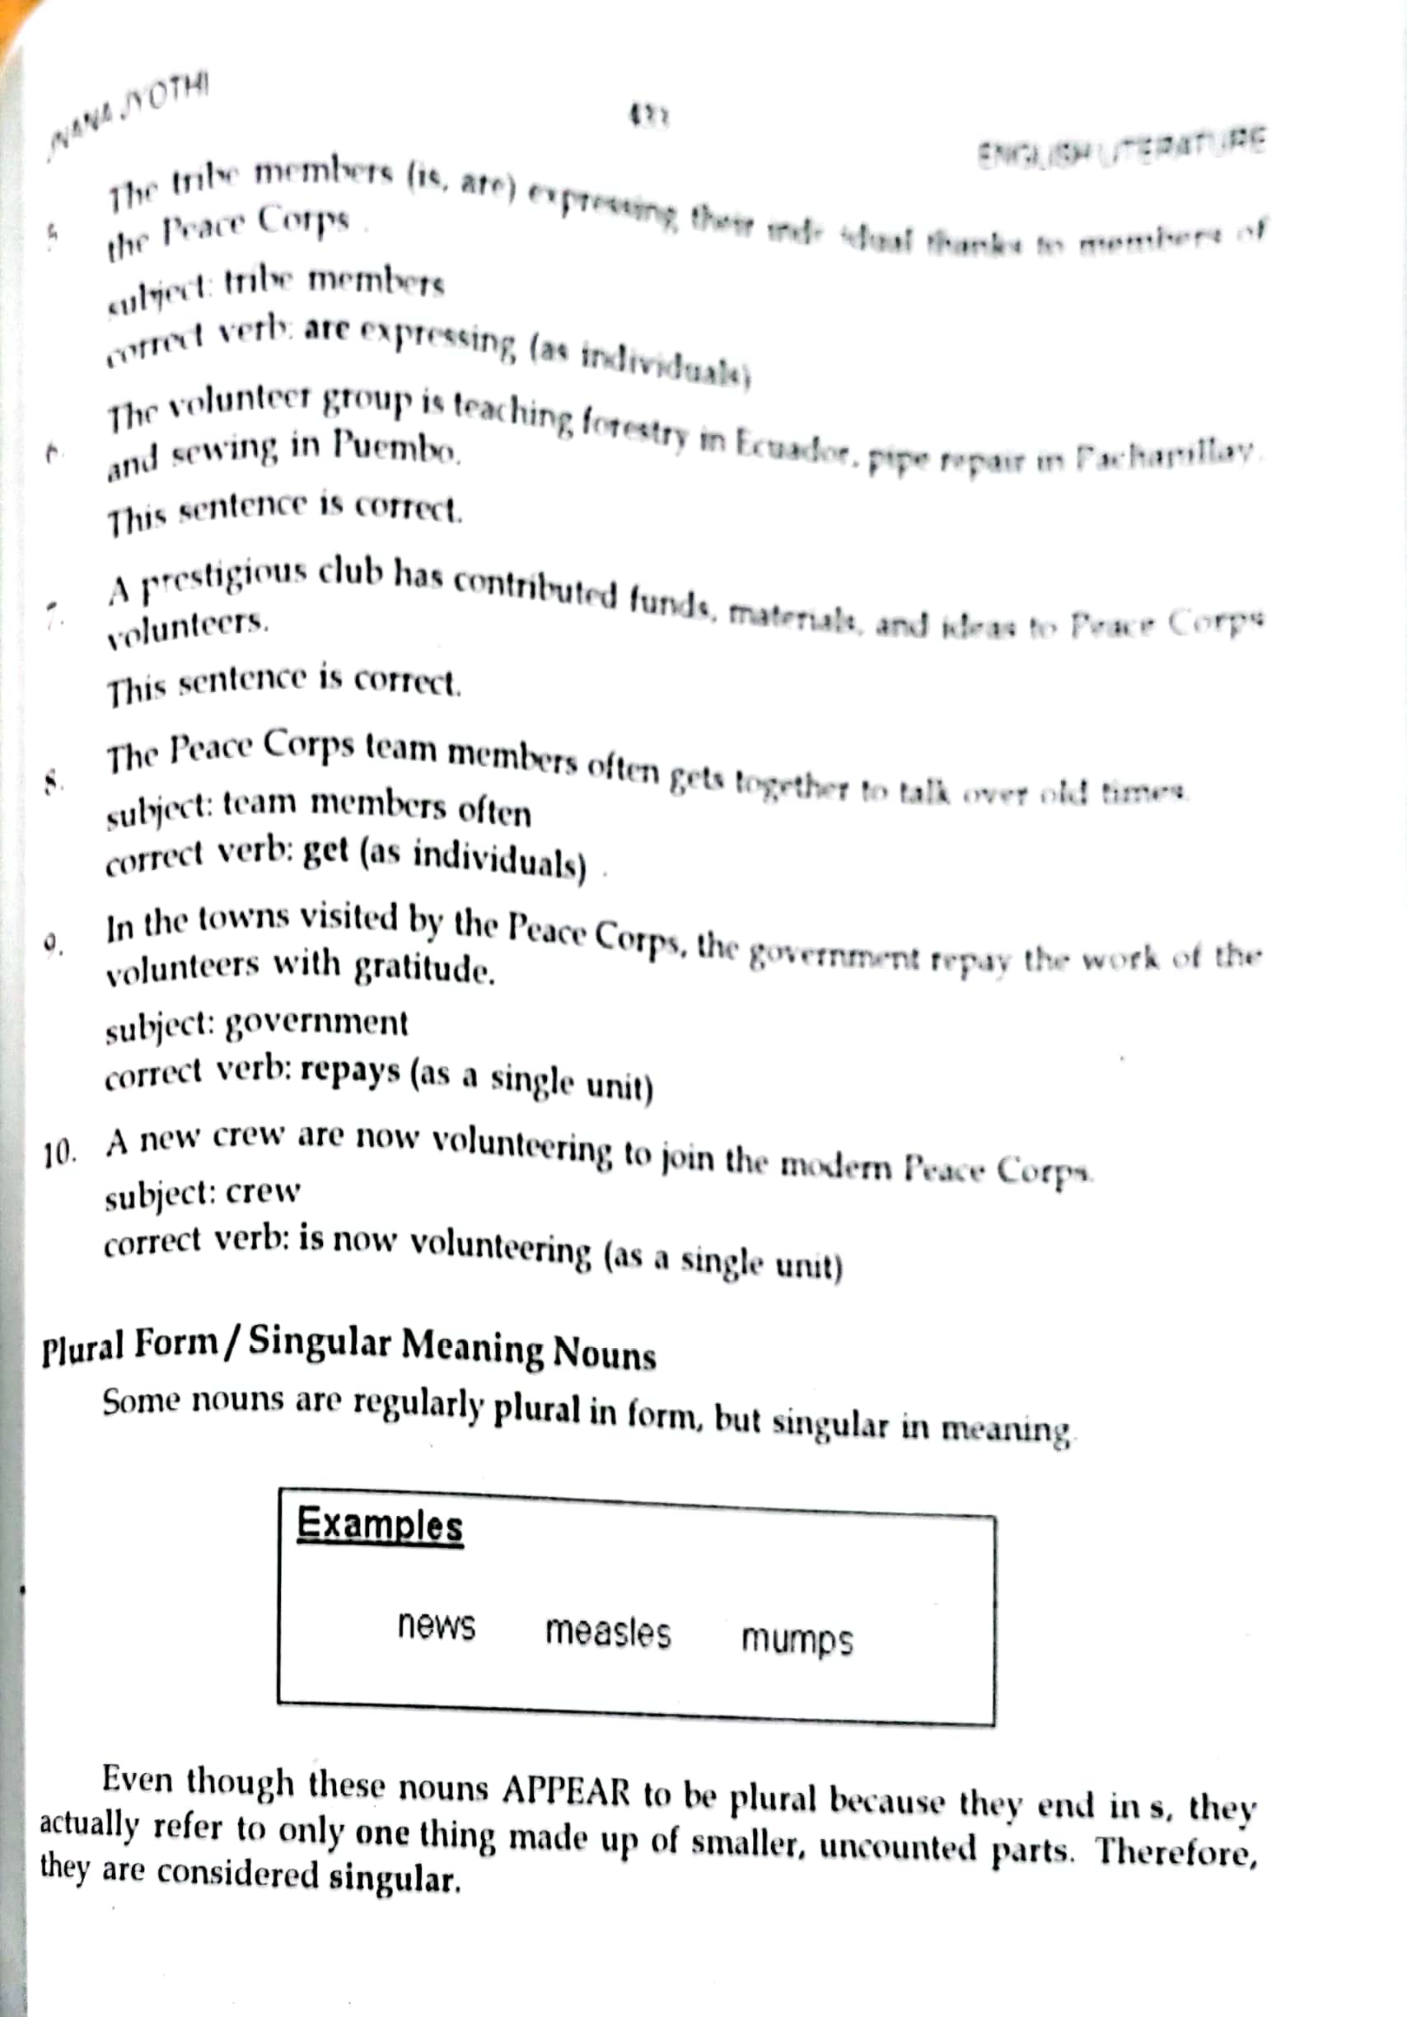

Slide 68
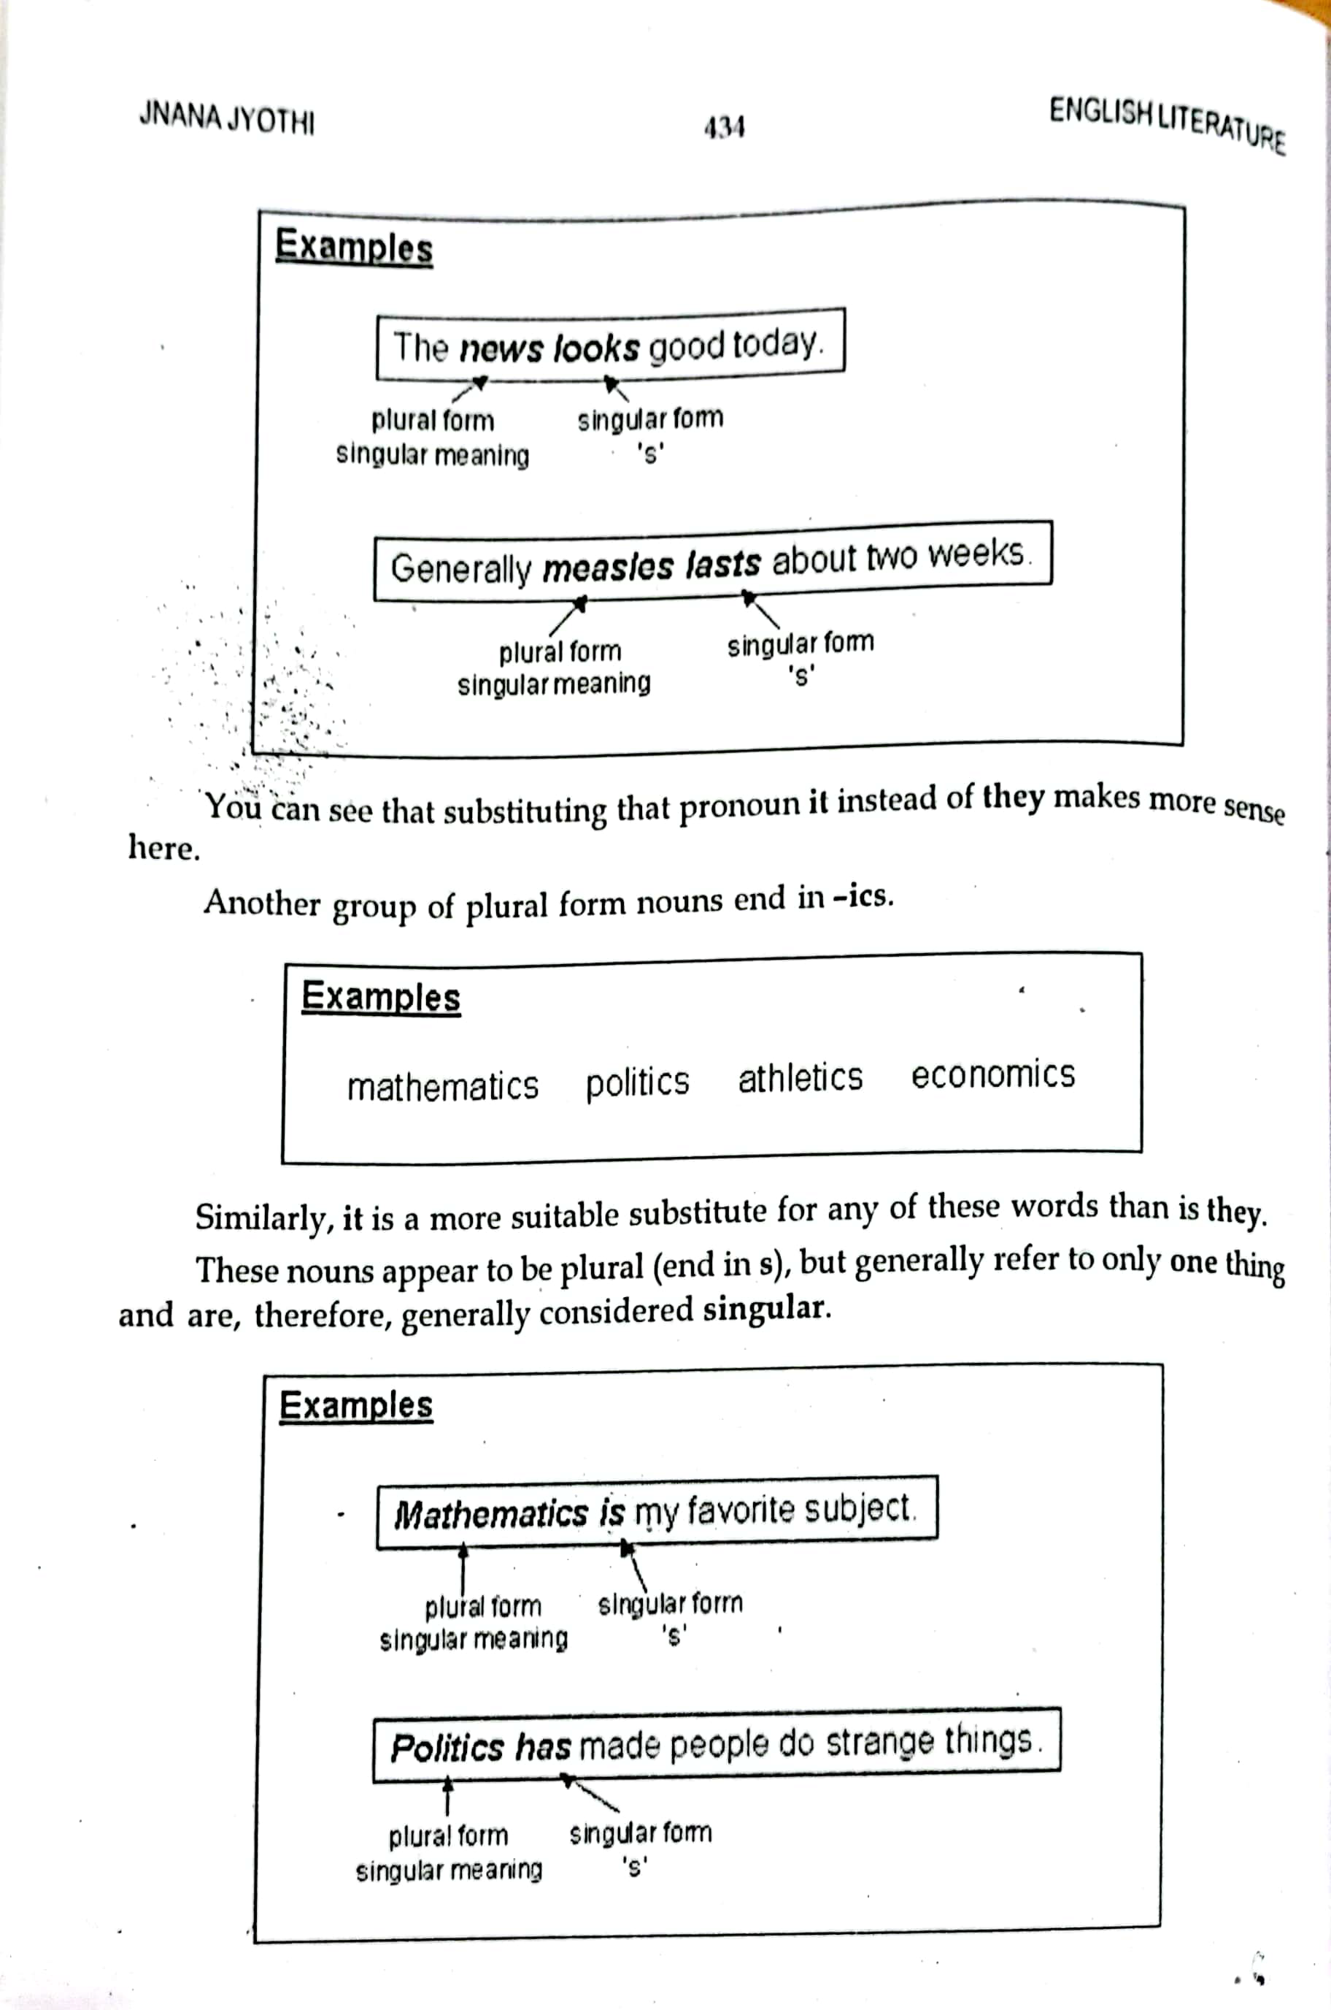

Slide 69
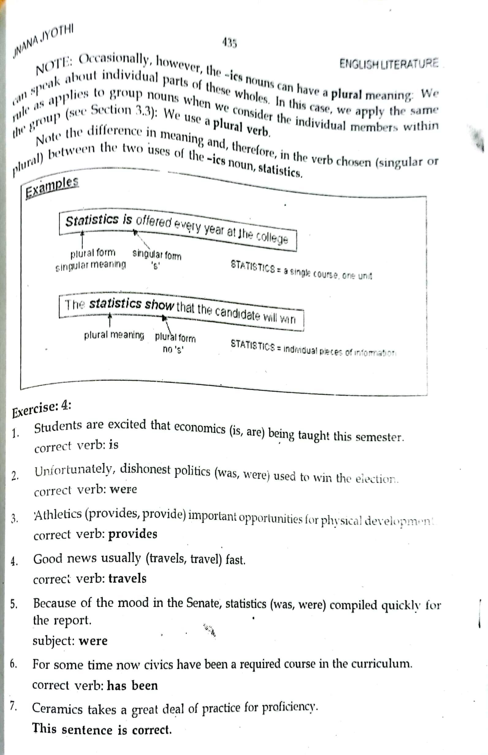

Slide 70
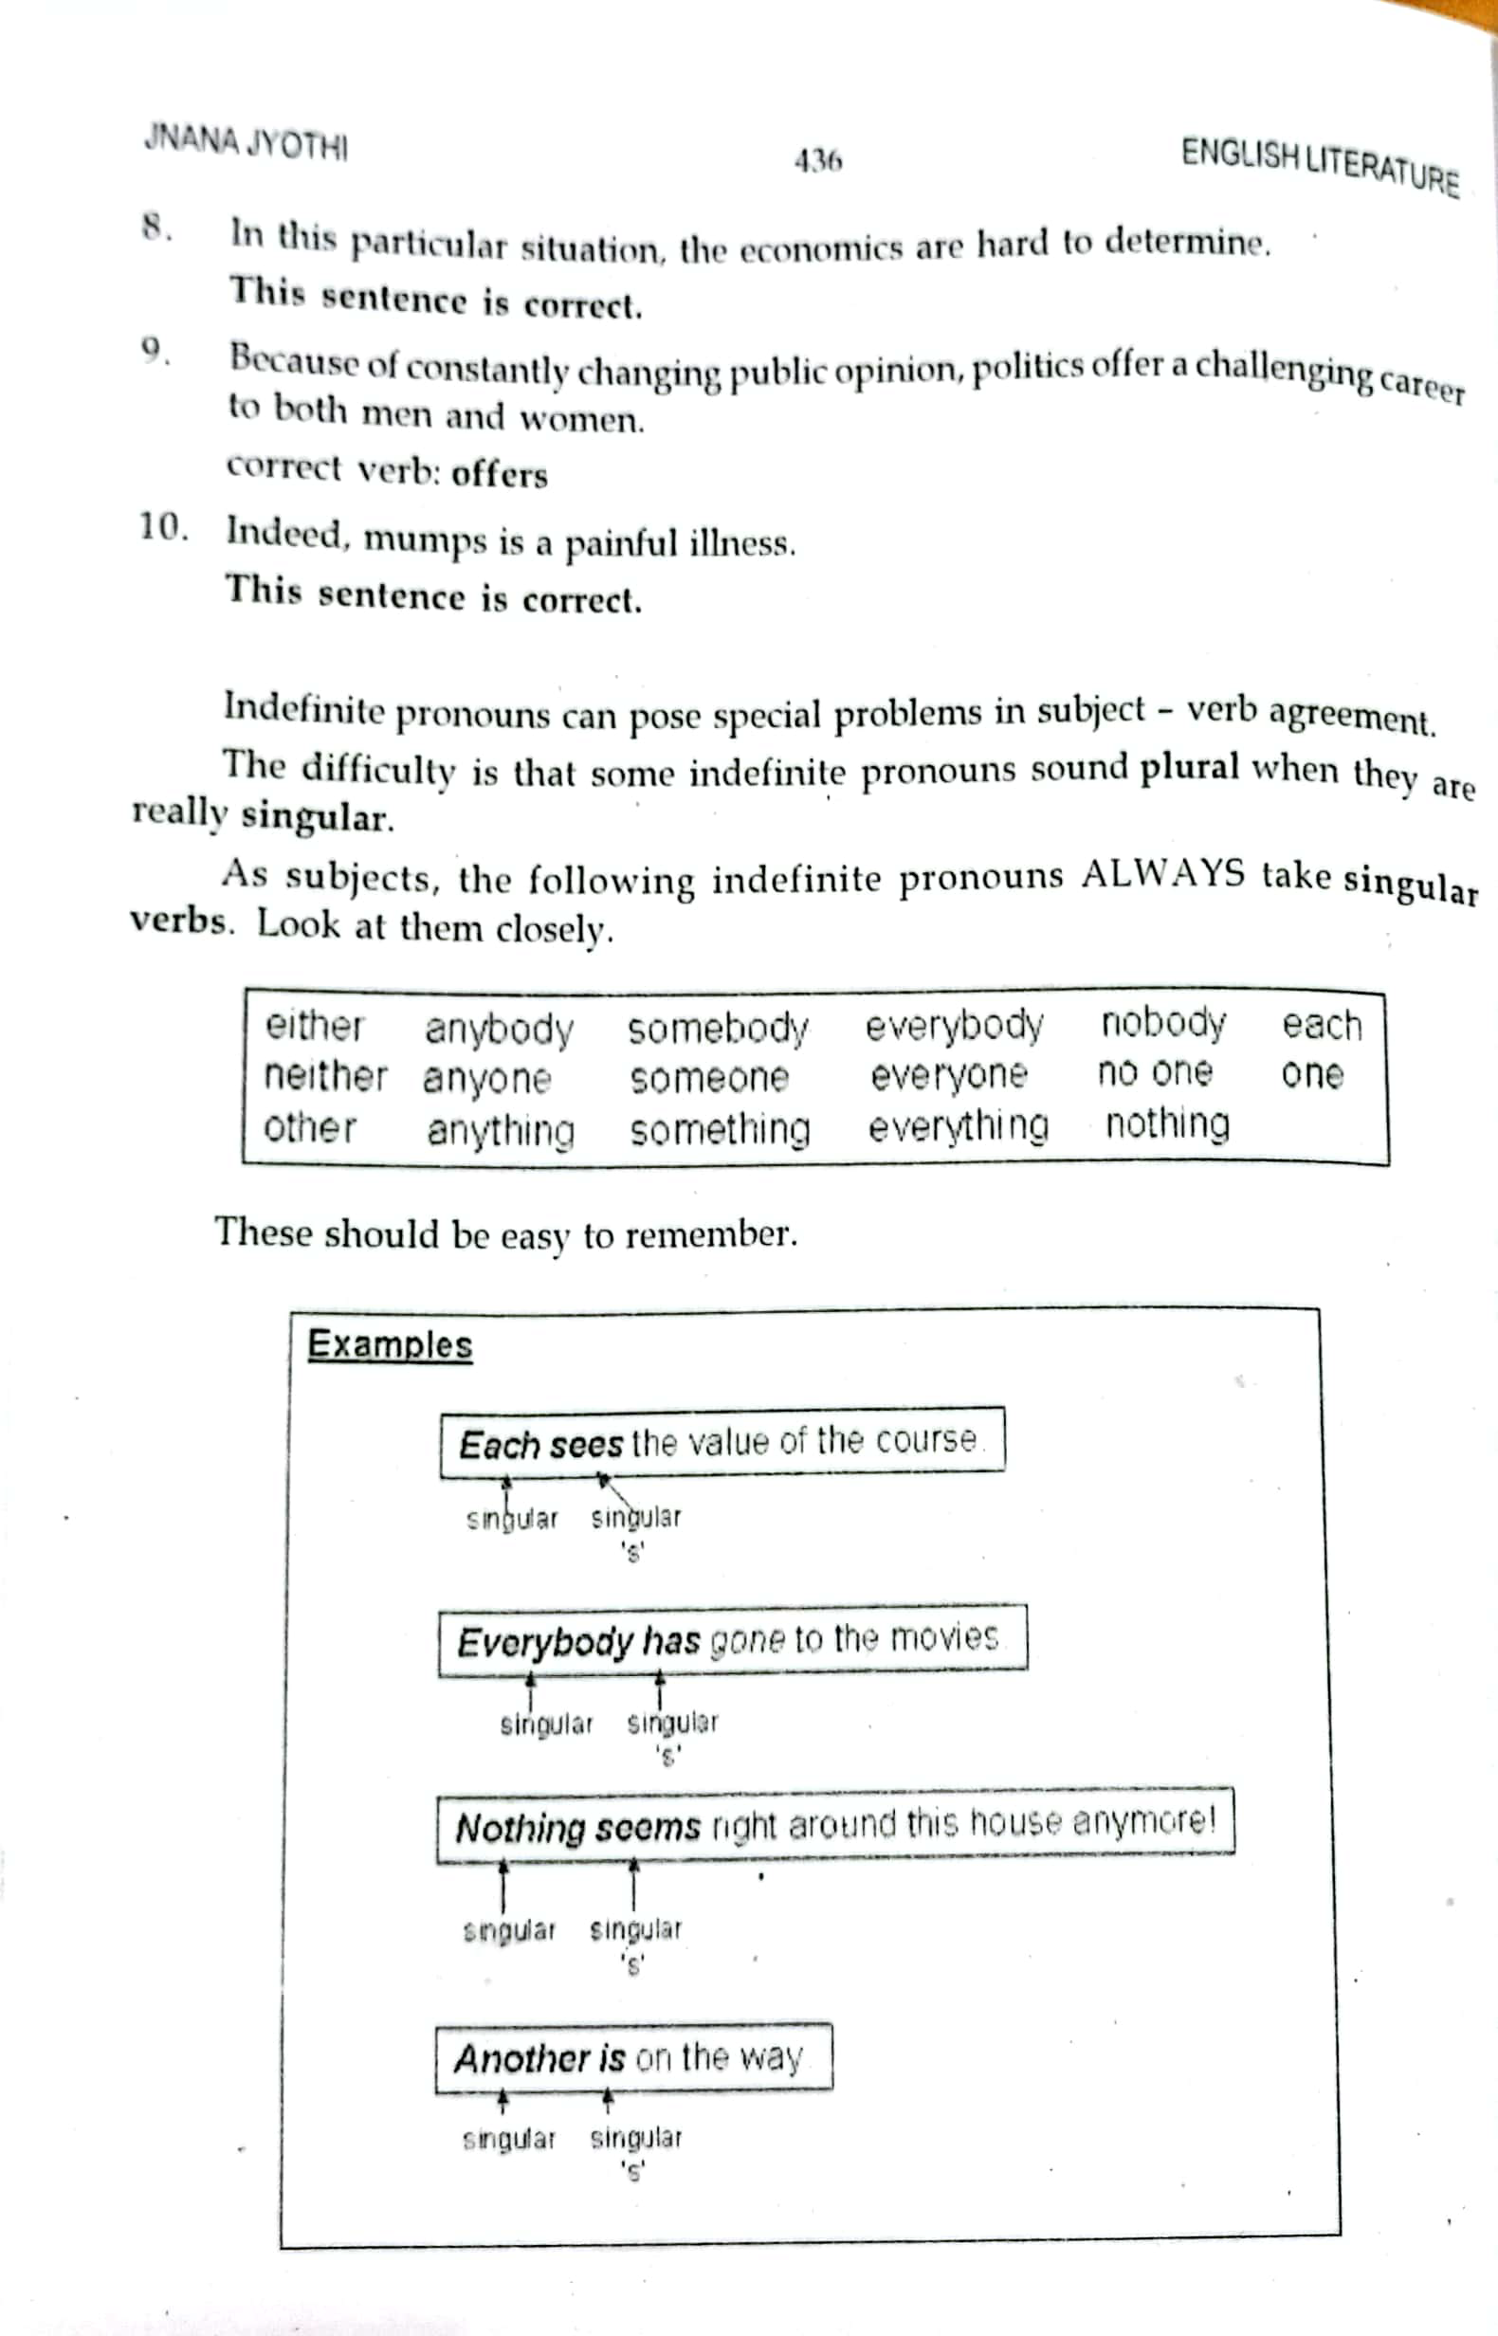

Slide 71
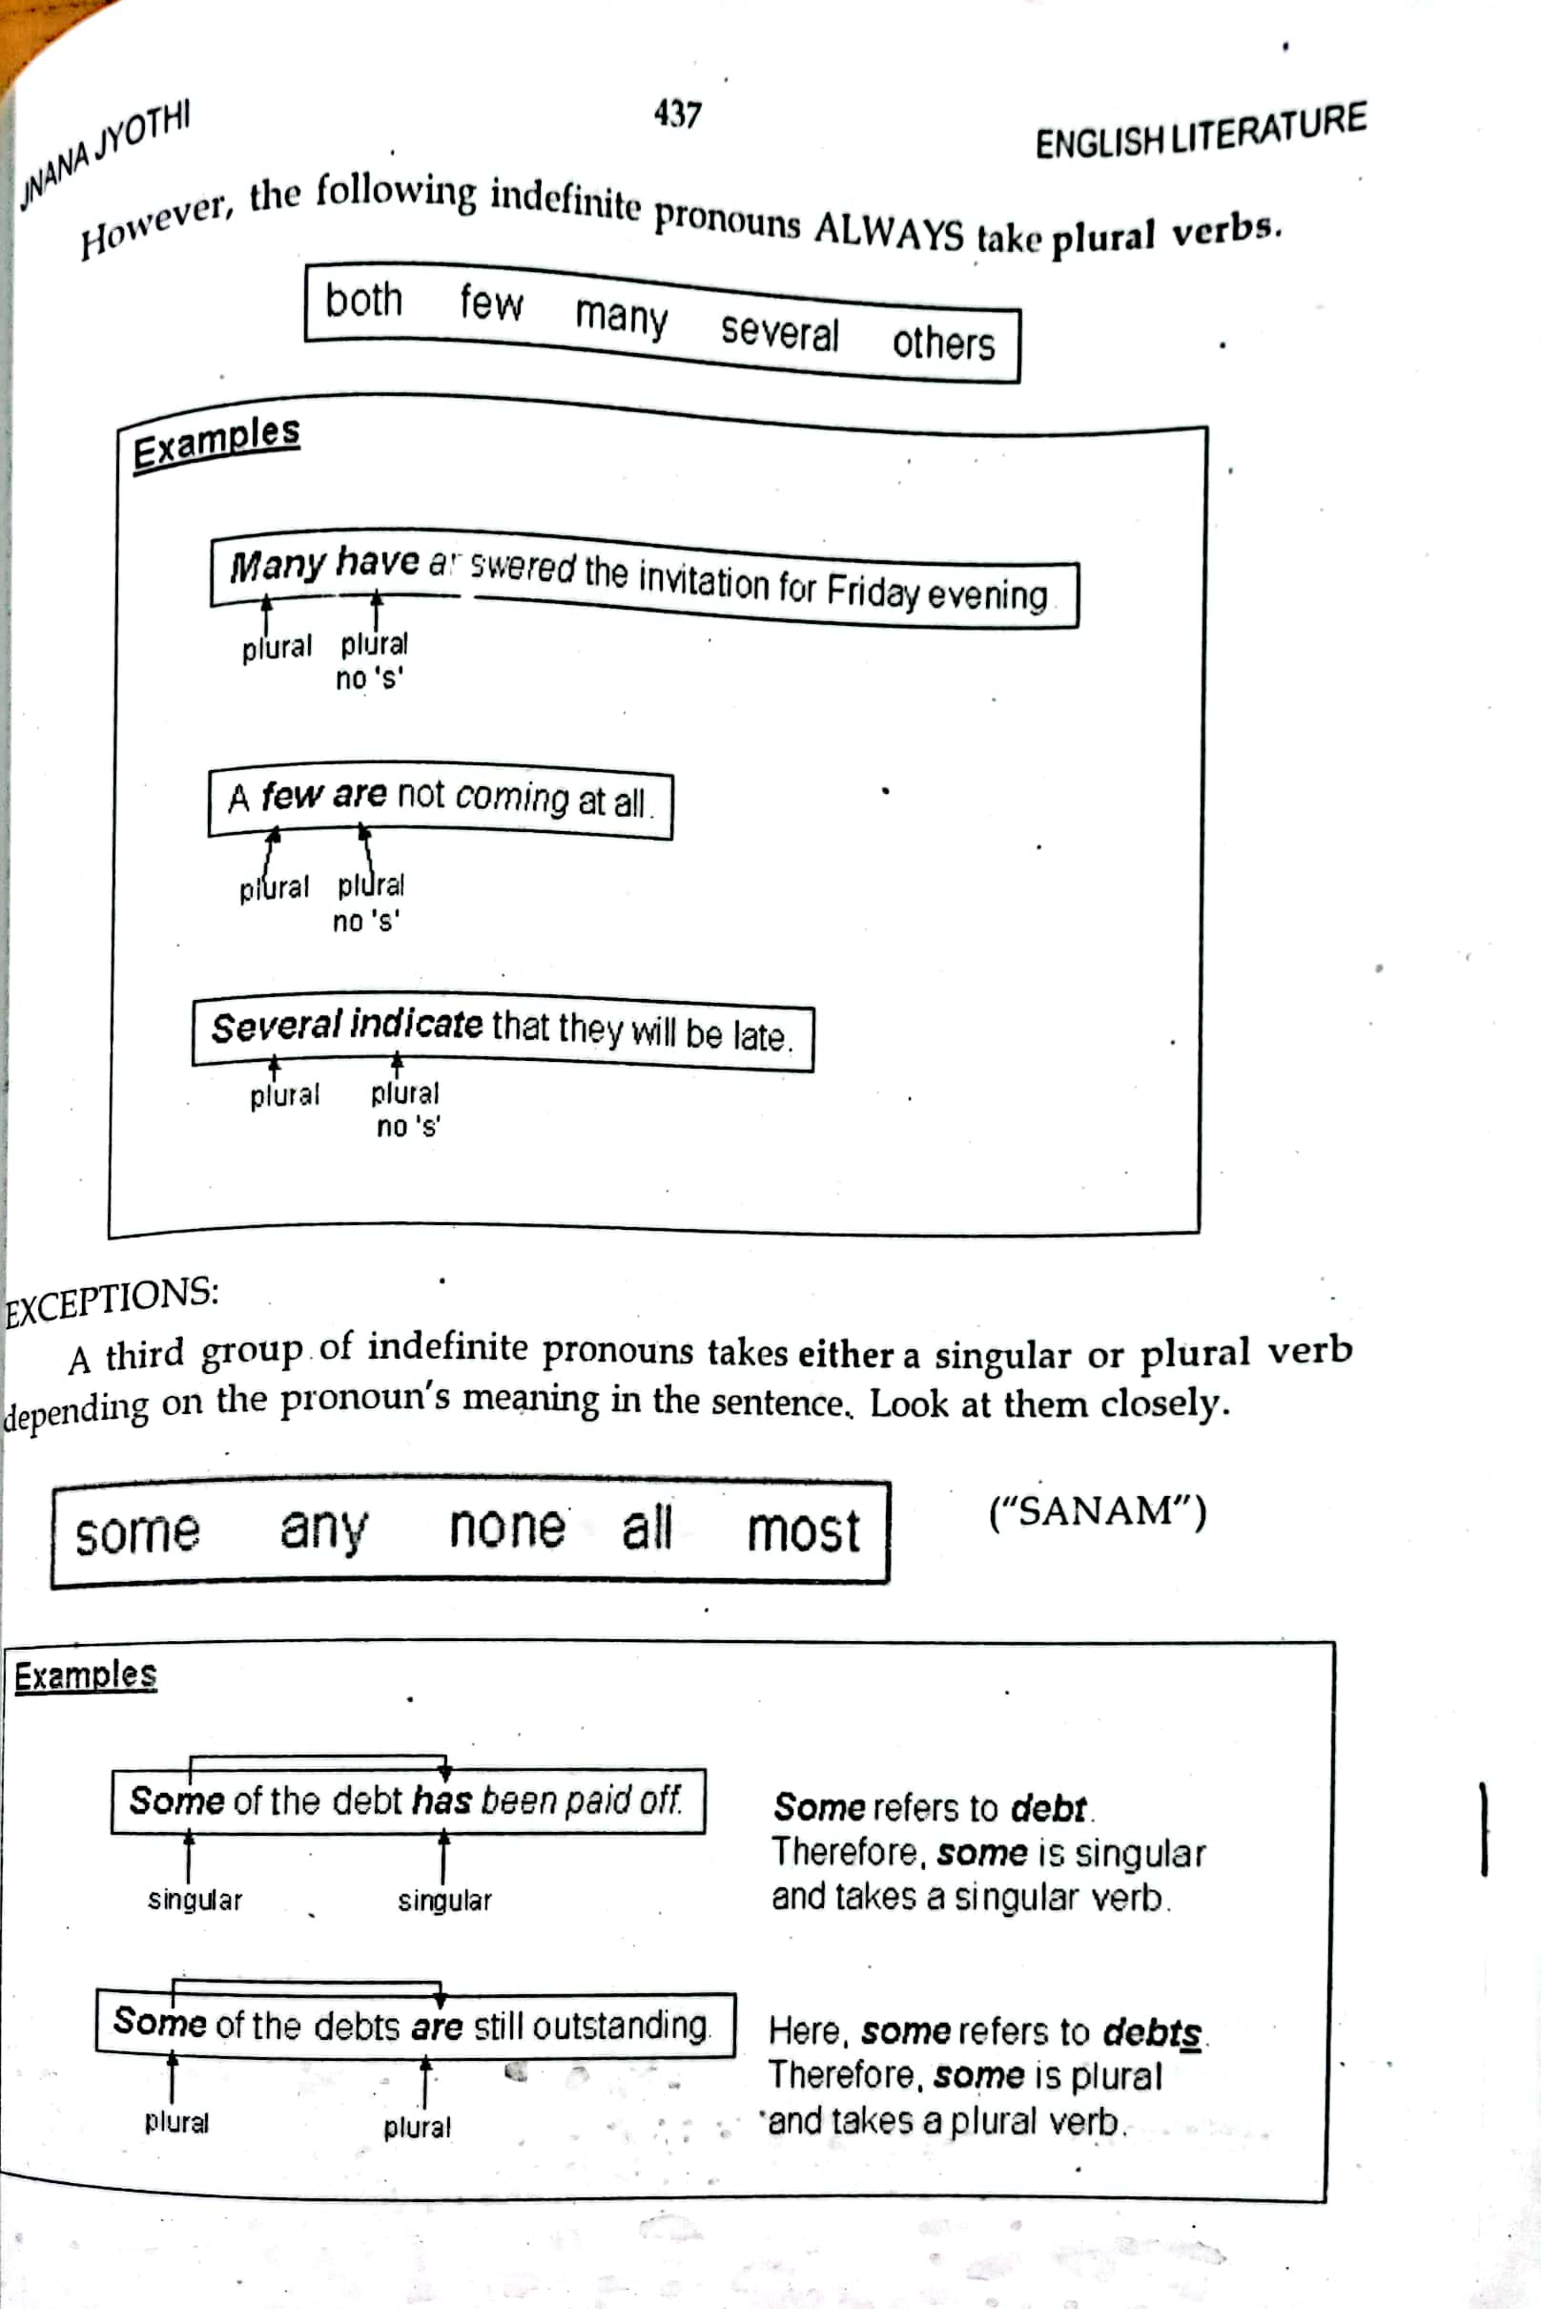

Slide 72
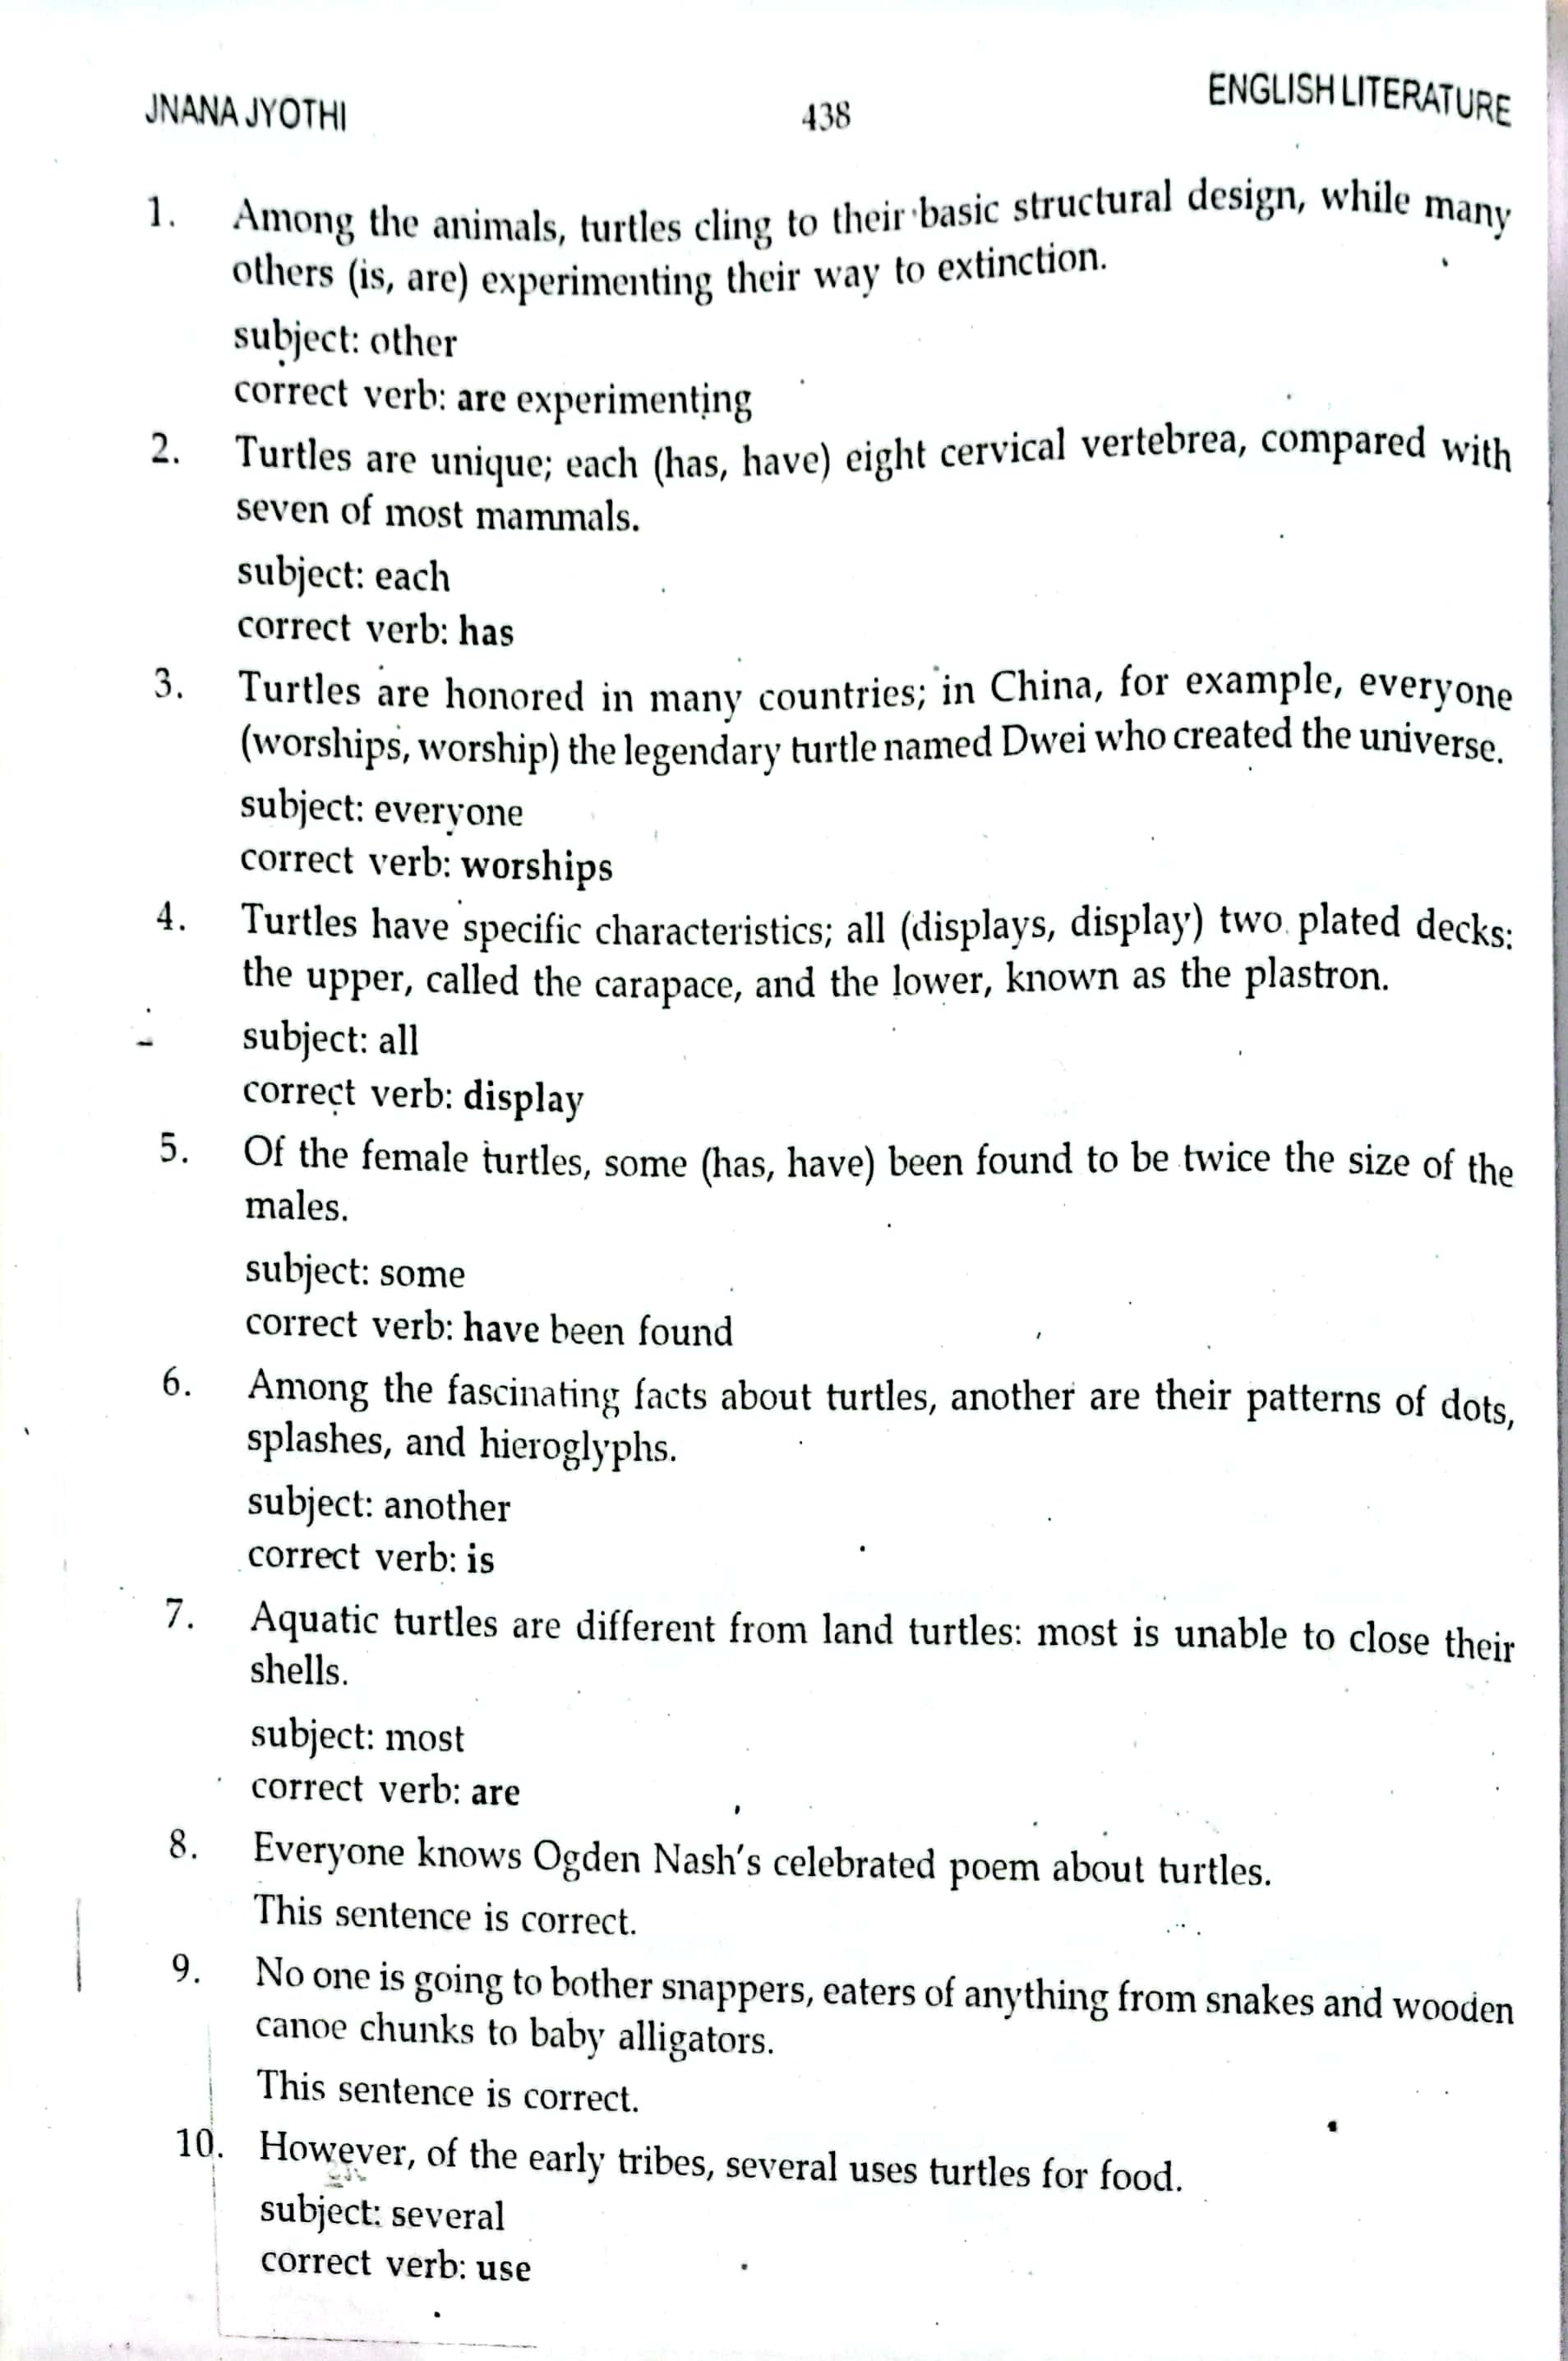

Slide 73


